Slide 1

Computational Finance and Machine Learning in Finance
Antoine Savine

Slide 2
all the material, slides, code, notebooks, spreadsheets and more sites.google.com/view/antoinesavine-compFinLecture

Slide 3

Need for Speed

Slide 4

Need for Speed
Recall from basic theory of derivatives:
Institutions must compute the value of the many transactions in their derivatives books
And their sensitivities to (many) market variables
remember sensitivities are hedge ratios
Rapidly, so they can hedge risk
Before market moves

Slide 5
Need for Speed: derivatives books
idealized world | real world
Transaction: European call option | Transactions: European calls and puts, basket/worst-of options, caps and swaptions, Bermudan (early callable) transactions, barrier and other path-dependent options, hybrids (dependent on many assets of different classes), volatility swaps, autocallables…
Model: Black & Scholes | Sophisticated models match complex risks Local and stochastic volatility (Dupire) Yield curve models (Heath-Jarrow-Morton) Many more, all the way up to Gatheral’s “rough volatility” models
Parameters: Spot and Volatility | Many parameters reflect complex markets Interest rate curves (by maturity) Volatility surfaces (by expiry and strike) Correlations, volatility of volatility and more
Pricing and differences all analytic | Due to complexity and dimensionality: Analytics almost never feasible FDM (finite difference methods) almost always impractical Slower, less accurate Monte-Carlo the only practical solution
Pricing and risk takes a few calls to analytic functions | Pricing and risk takes thousands of differentials of prices of thousands of transactions, estimated with thousands of Monte-Carlo simulations

Slide 6
Need for Speed: regulations
Modern models, algorithms and hardware can deal with derivatives books
But regulators insist (for good reason) that we compute value and risk
Not only today
But also:
On a set of future dates: “exposure dates”
In multiple scenarios relative to market evolution
So even basic transactions like swaps or forwards become highly exotic
And computational requirements increase by orders of magnitude

Slide 7

Counterparty Value Adjustment (CVA)
Prominent example of regulatory risk computation: counterparty credit risk adjustment
Say I buy a 2Y ATM (spot=100) call from party A, sell it to party B
This is called “back to back trading”, in principle, risk-free
One year from now, party A defaults
A will not deliver the payoff of the call one year later
My position against B is now unhedged
I can hedge it by buying another 1Y 100 call in the market
Or implement a replication strategy
Either way, I must pay the premium of the call, again
Counterparty default may produce a loss (of a stochastic amount) but never a gain
Every time I trade with a defaultable party, I am giving away a real option
A
buy call
sell call
B
no payoff
payoff
default

Slide 8
CVA as an option
At the time T when a counterparty defaults, I have a (negative) payoff of
where V is the value, at T, of the sum of all transactions with the party (called “netting set”)
including swaps, options, exotics, hybrids, etc.
Note that V depends on the market value at T of all assets underlying to all transactions in netting set
plus path-dependencies (were Bermudans early exercised before T? were barriers hit before T? Etc.)
The payoff of the real option I am implicitly giving away when trading is therefore:
where tau is the (stochastic) time of default
this is also often written as a continuous integral
This is a complicated, hybrid options that depends on credit and the joint dynamics of all underlyers in the netting set
even when the transactions in the netting set are basic

Slide 9
CVA: pricing
CVA is priced like any other option (ignoring discounting for simplicity):
Assuming credit is independent from market drivers of the netting set:
the left term in the sum is the (risk neutral) probability of default, can be read in credit markets (Bonds, credit default swaps)
the right term is the expected loss given default (LGD) , or “exposure”
Exposures depend on credit, and the joint dynamics of all asset that affect the netting set --- so we need:
Complex hybrid models, in practice “stitching together” models of all underlying assets, with special care to remain consistent and arbitrage-free
Monte-Carlo simulations (given the high dimensionality)
Some way to compute future book values V from the simulated state of the market at T
for example with nested simulations (Monte-Carlo within Monte-Carlo)
can we do better? for example, “learn” future values from data, with machine learning?
All of this is a (very) active field of current research, see for example Huge & Savine’s Deep Analytics
The computational requirement is massive: CVA is often computed in large data centres
With better algorithms and platforms, we can compute it locally --- see Andreasen’s influential Calculate CVA on your iPad Mini
But it may still take several minutes to compute the price alone

Slide 10
CVA: risk conundrum
Regulators insist that institutions (frequently) compute CVA and incorporate it in accounts as a loss, hence “adjustment”
From one day to next, market may move and modify CVA by hundreds of millions
But CVA is part of the bank’s profit and loss account
Banks cannot tolerate such swings
Like any other option, CVA must be hedged
Compute sensitivities of CVA to all market variables, and hedge them in the market, as usual
Problem is: CVA typically depends on thousands of market variables
all the rate curves and volatility surfaces in all the currencies in the netting set
all the exchange rates and their volatility (surfaces)
plus of course all underlying assets and their volatility (surfaces)
If it takes minutes to compute one CVA price, it may take days to compute one risk
by traditional means, bump market variables one by one and recalculate, also called “finite differences”
this is far too late: we must hedge before asset prices change in fast moving markets

Slide 11

Speed is a matter of life or death
Speed (without loss of accuracy!) is a matter of survival
In addition to CVA, banks must compute (and hedge!!) similar adjustment for funding (FVA), initial margin (MVA) and many more
collectively called “XVA”, see Gregory’s classic XVA Challenge
Banks who can’t compute and hedge risks on time are out of the business
Principal focus of quantitative research and development groups is shifting towards fast models, algorithms and platforms

Slide 12


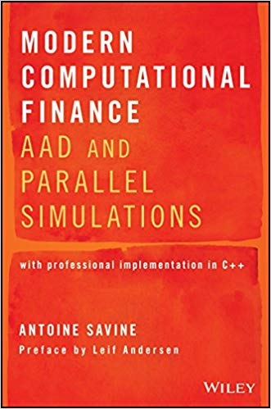
How to achieve speed: classic avenues
Improve Monte-Carlo convergence
“Better random numbers”: Sobol’s sequence
Control variates:
Antithetic: for every path, generate another with reflected Brownian
Model specific: adjust paths to hit discount factors, European options…
Many flavours of variance reduction techniques (Generally problem specific)
Well known and taught all explained in Glasserman and Jaeckel’s classic books
Improvement typically (sub-)linear
Leverage modern hardware
Cache awareness
Multi-threaded programming, SIMD
GPU, TPU
Less classic, seldom taught in finance all explained in Savine’s Modern Computational Finance
Yet major (linear) improvement on modern hardware
faster

Slide 13
How to achieve speed: cutting edge
Adjoint Differentiation (AD)
We compute differentials by bumping, repeatedly recalculating value
What if we could compute value and all differentials, at once, in a time independent of the number of differentials?
We would get full risk for a time similar to one computation of the value
This is what AD and its automatic instance AAD offer: an order of magnitude improvement in speed, and the most prominent leap in computational finance since finite difference methods (FDM) in the 1990s
Recent addition to finance
Smoking Adjoints paper by Giles & Glasserman, 2006
Award-winning Bank-wide implementation in Danske Bank, 2015
Similar tech also powers machine learning (where it is called “back-prop”)
Not yet well understood or systematically taught in financial programs
AD is the principal focus of this course
and of Savine’s Modern Computational Finance
fastest

Slide 14
How to achieve speed: future tech
Rise of Machine Learning
Values and risks of trading books are (very complicated) functions of the state (market + path-dependencies)
In principle, this function can be taught to machines
In a way similar to how your phone identifies people by “looking at” them: target (identity) is a (learned) function of state (pixels on camera)
Many ideas from the Machine Learning (mainly Deep Learning) world are being applied in finance as a very current, very active area of research & development
May lead to another leap in computational speed
See first public milestones (all from 2018-2019):
Horvath, Deep Learning Volatility
Mc Ghee, An Artificial Neural Network Representation of the SABR Stochastic Volatility Model
Huge & Savine, Deep Analytics
even faster?

Slide 15
Summary of the course
Programming for speed: 2 hours
Deep Learning and back-prop: 4 hours
Adjoint Differentiation: 4 hours
Design Patterns for Simulation Systems: 2 hours
Parallel simulations in C++: 2 hours
Important note:
in these lectures, we implement basic, toy C++ code, optimized for simplicity and pedagogy
professional code, optimized for production and efficiency, is available in the curriculum
and its companion GitHub repo GitHub.com/aSavine/compFinance
sites.google.com/view/ antoinesavine-compFinLecture
your curriculum
your companion site

Slide 16
Programming for Speed

Slide 17
Demonstration 1: matrix product 30x faster
C++ code:
GitHub.com/aSavine/CompFinLecture/MatrixProduct
Python notebook:
GitHub.com/aSavine/CompFinLecture/MatrixProductPython
Curriculum:
chapter 1

Slide 18
Demonstration 2: Dupire’s model (1992)
Extended Black & Scholes dynamics (in the absence of rates, dividends etc.):
Calibrated with Dupire’s celebrated formula: with C(K,T) = call prices of strike K, maturity T
Implemented with a (bi-linearly interpolated) local volatility matrix:
Volatility matrix: 21 spots (every 5 points 50 to 200) and 36 times (every month from now to 3y) we have 1,080 volatilities + 1 initial spot (=100) = 1,081 model parameters
Valuation of a 3y (weekly monitored) barrier option strike K=120, barrier B=150:
Solved with Monte-Carlo or FDM over the equivalent PDE (from Feynman-Kac’s theorem)
We focus on Monte-Carlo simulations here: 500,000 paths, 156 (weekly) time steps

Slide 19
Demonstration 2: Results
Implementation
C++ code exported to Excel (see tutorial ExportingCpp2xl.pdf on the GitHub repo, folder xlCpp)
Generic library design with efficient implementation (Chapter 6)
Parallel implementation (Chapters 3 and 7)
Sobol quasi-random numbers (Chapters 5 and 6), excerpt here: medium.com/@antoine_savine/sobol-sequence-explained-188f422b246b
Advanced AAD with expression templates (Chapter 15)
Hardware: quad-core laptop (surface book 2, 2017)
Performance:
One evaluation with 500,000 paths over 156 time steps take ~0.8sec
We have 1,081 risk sensitivities, take about 15 minutes to produces model risk report with linear differentiation
With AAD the 1,081 differentials are produced in ~1.5sec

Slide 20
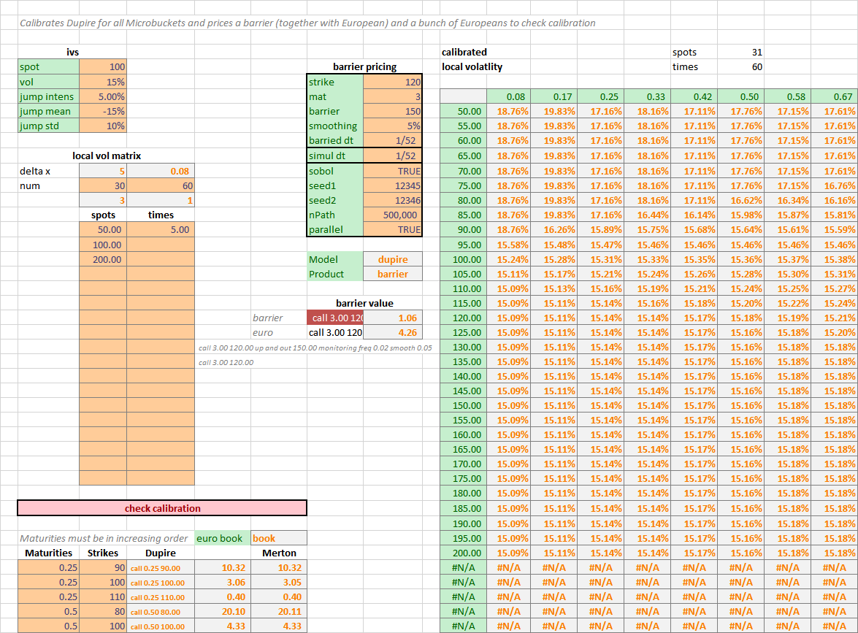
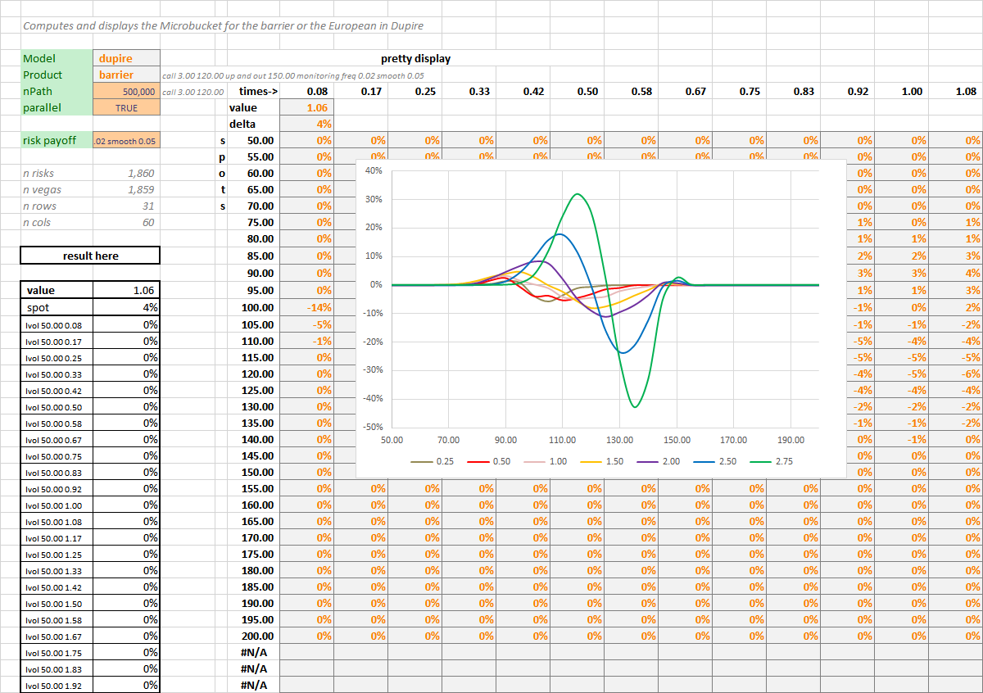
Demonstration 2: material
GitHub repo (github.com/asavine/CompFinance)
Prebuilt Xl addin xlComp.xll (may need to install redistributables VC_redist.x86.exe and VC_redist.x64.exe)
Demonstration spreadsheet xlTest.xlxs

Slide 21
Deep Learning

Slide 22


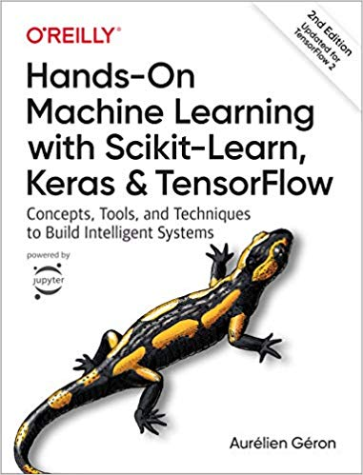
Neural networks and deep learning
We briefly introduce deep learning here
A lot of learning material is found in books, MOOCs and blogs
Quality is uneven, we recommend the following:
Andrew Ng’s videos on Coursera
Goodfellow’s reference book
Geron’s practical introduction with TensorFlow (2nd ed)

Slide 23
Linear regression
Linear model (joint Gaussian assumptions):
Parameters:
Parameters are fitted to a dataset set of input vectors where targets are known
Fit means find parameters that minimize prediction errors
Then, the fitted model – with fitted parameters is applied to new examples to make predictions for unknown target

Slide 24

Linear classification
Alternatively, classification problems predict discrete categories
Example: identify animals in pictures: 0: not an animal, 1: cat, 2: dog, 3: bird, 4: other animal
Regression more relevant than classification in quantitative finance
Deep learning community typically focuses more on classification
See literature for details, for example Stanford’s CS229 on cs229.stanford.edu/syllabus.html
This lecture sticks with regression
Everything that follows generalises easily to classification and the maths remain essentially identical
picture 1920x1080x24bit colour
vector of 1920x1080 pixels
Parameters:
b: vector of dimension 5
w: matrix 5 x 2,073,600
s: softmax function
softmax regression

Slide 25
Linear fit
Training set of m examples (each a vector in dimension n) with corresponding labels
Learn parameters: by minimizing prediction errors (cost function)
Note that this is the same as maximizing (log) likelihood under Gaussian assumptions, hence: are the maximum likelihood estimators (MLE) for the Gaussian model
b* and w* are found analytically, solving for
Result (“normal equation”):
Solution is analytic and unique: no local minima since C is convex (quadratic) in b and w

Slide 26
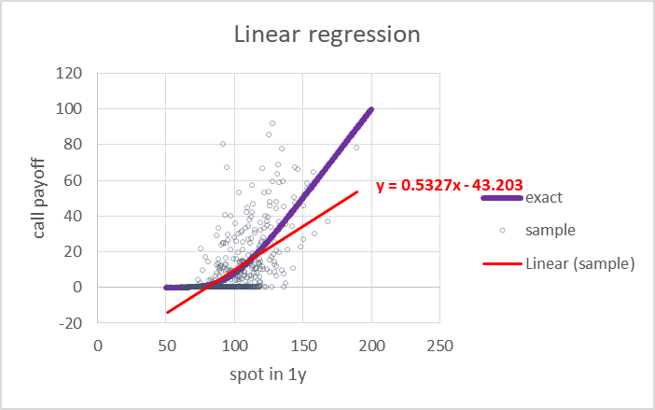
Linear limitations
Important example: revaluation
Predict the future price in 1y of a European call strike 100, maturity 2y
By regression of the payoff in 2y:
Over the underlying asset price in 1y:
Gicen a training set of m paths
generated under Black & Scholes’ model (spot = 100, volatility of 20%)
We know the exact solution is given by Black and Scholes’ formula so we can assess the quality of the regression
See spreadsheet reval.xlsx on the repo github.com/asavine/CompFinLecture/RegressionSheet/
Linear regression obviously fails to approximate the correct function because it cannot capture non-linearities

Slide 27
Basis function regression
hidden layer
= basis functions
= features of x
Solution: regress not on x but on basis functions a of x
Example: polynomial regression
Basis functions = monomials (x is in dimension ):
1st degree:
2nd degree:
3rd degree:
Etc.
Prediction in two steps:
Start with the vector x of inputs
Compute vector of basis functions (or “features” in ML lingo):
Predict linearly in the basis functions:
Fitting: identical to linear regression on a in place of x
output layer = prediction
original features
= input layer
linear regression

Slide 28
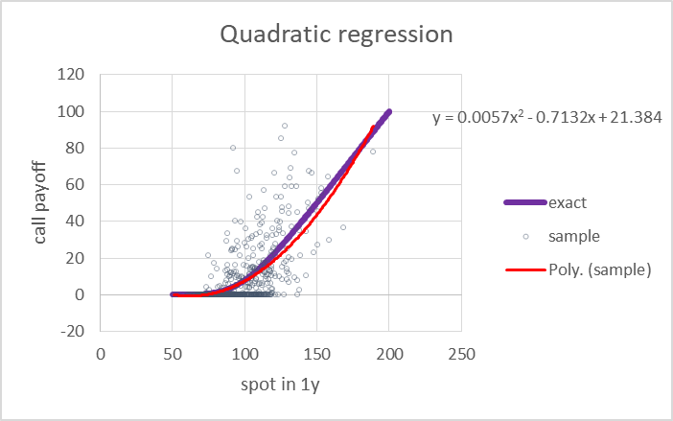
Power of basis function regression
Works nicely: quadratic regression of over approximates Black & Scholes’ formula very decently in simulated example
Remarkable how the algorithm manages to detect Black & Scholes’ pattern in noisy data
Run it yourself, reval.xlsx on the repo github.com/asavine/CompFinLecture/RegressionSheet/
Solution remains unique and analytic
Mathematical guarantee:
Combinations of polynomials can approximate any smooth function to arbitrary precision
Hence, detect any (smooth) non-linear pattern in data
But only with a large number of basis functions / high polynomial degree

Slide 29
Curse of dimensionality
How many monomials in a p-degree polynomial regression?
Number of basis functions (dimension of a) grows exponentially in number of features (dimension of x)
Precisely:
Examples:
Quadratic regression: dimension grows e.g. from 10 to 65, from 100 to 5,151, from 1,000 to 501,500
Cubic regression: dimension grows 10 to 286, 100 ➔ 176,851, 1,000 ➔ 167,668,501

Slide 30
Explosion of basis functions
In the general case, basis is not necessary polynomial
Other possibilities include spline basis, Fourier basis and many more
Number of basis functions always explodes when dimension grows
Intuitively: we fix basis functions irrespective of data set
We expect our set of fixed basis functions to perform well with all datasets
So we need a large number basis functions
Explosion of basis functions is a computational problem: prediction and fitting become prohibitively expensive
Another problem with a large number of fitted parameters is overfitting

Slide 31
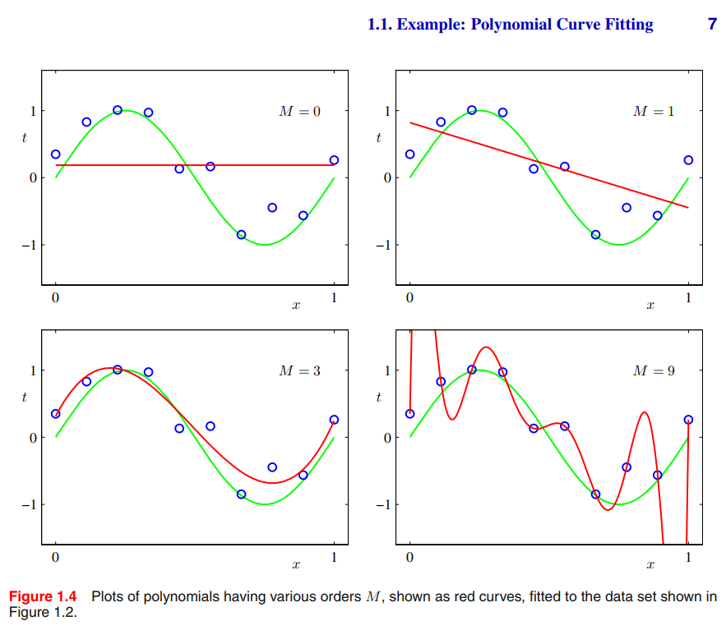
Overfitting and the variance-bias trade-off
From Bishop (2006) Pattern Recognition and Machine Learning
If you fit a linear model with n free parameters to n data points
You will find a perfect fit
But the model may not generalize well to new examples
Because it captured the noise of the particular training set
This is called “overfitting” and relates to “variance” because the estimated model strongly depends on the dataset
Variance vanishes when the size of the dataset grows
Conversely, with too few parameters, you may fail to fit data
This is called “bias” because the estimated model fails to correctly represent data even asymptotically, when the dataset grows
Trying to fit a linear model to learn call prices (a few slides back) is one example of bias
This is all properly formalized as the “variance-bias trade-off”
See for instance Bishop’s Pattern Recognition and Machine Learning
Or summary on Quora: quora.com/Does-neural-network-generalize-better-if-it-is-trained-on-a-larger-training-data-set-Are-there-any-scientific-papers-showing-it/answer/Antoine-Savine-1
Solutions exist to mitigate overfitting, called “regularization” See Stanford’s Machine Learning class on Coursera or Bishop’s book
The most obvious and effective regularization is to increase the size of the training set
Tule of thumb: at least 10 times as many training examples as the number of free parameters (“rule of 10”)
So the required size of the training set also explodes with the number of basis functions!

Slide 32
ANN: learn basis functions from data
BASIS FUNCTION REGRESSION
hidden layer = arbitrary set of basis functions
pre-processing = not part of the model, no learned parameters
ANN
hidden layer = learned set of basis functions
part of the model, subject to trainable parameters
output layer = prediction
output layer = prediction
linear regression over basis functions
linear regression over basis functions
identical

Slide 33
Learn features from data
Instead of a fixed set of basis functions, irrespective of data (hence we need many of those)
We fix the number of basis functions (recall, also called “features”)
And learn the “best” ones from data
So we end up with features that adapt to data (hence we don’t need so many of those)
How do we learn basis functions a from the data?
Parametric family of basis functions: ➔ each basis function ai is a parametric function of the same vector of inputs x each with different parameters θi
Learn parameters (along with the weights w and bias b of regression) by minimization of the cost (e.g. sum of squared errors)

Slide 34
Perceptron
Perceptron = (by far) most common choice of parametric family of basis functions
Each basis function ai is some non-linear scalar function g of a linear combination of the xs In other words, each feature is a different combination of the same xs, activated by a given scalar function g
g: scalar function called “activation”, applied element-wise to the vector
Each is a vector of parameters of dimension and each is a real number parameter
Hence, if is a matrix and is a dimensional vector
Then, the vector of basis functions is where g is a scalar function applied element-wise to the vector
The activation function g
Is, in principle, arbitrary
Must be non-linear or we are back to a linear regression (a linear combination of linear functions is a linear function of the inputs)
(Must satisfy some technical requirements for the perceptron to represent any function)

Slide 35
Perceptron (2)
Perceptrons have two major benefits:
Computational
Perceptron networks are sequences of matrix operations
(Matrix products followed by element-wise activations)
Executed very efficiently on modern parallel CPU, GPU and TPU
Representational
Perceptrons can represent any function
(in the asymptotic limit of an infinite number of basis functions)
Not unlike polynomial or Fourier bases
This is called the “Universal Representation Theorem”

Slide 36
Perceptron (3)
…
…
output layer: combination of basis functions
hidden layer: compute basis functions

Slide 37
Prediction with perceptrons
Prediction in two steps
Step 1 (hidden layer): feature (=basis function) extraction inputs x (dim n0) → basis functions a (dim n1)
Parameters: matrix in dimension and vector in dimension
The activation function g is scalar and applied element-wise on the vector
Step 2: (output layer): regression basis functions a (dim n1) → prediction (real number)
Parameters: row vector in dimension and real number
Unified notation for both steps = feed-forward equation or
For layers l = 0 and 1
With the notations and parameters

Slide 38
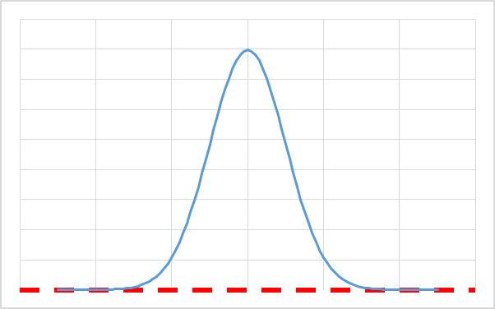
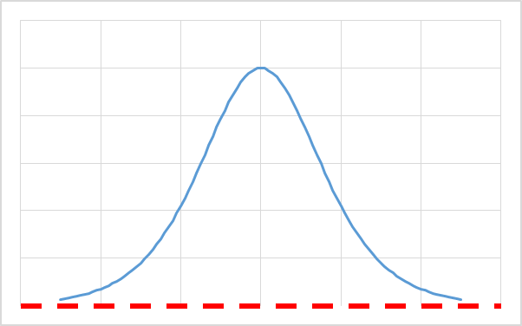
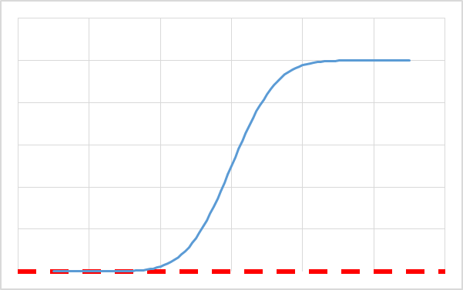
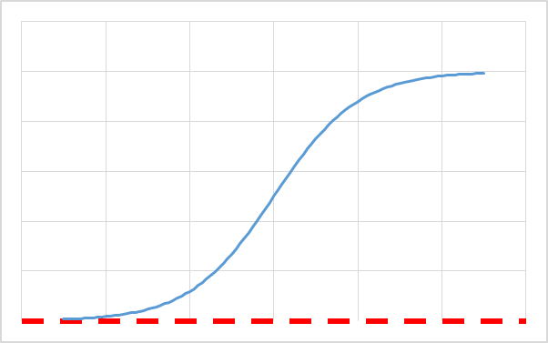
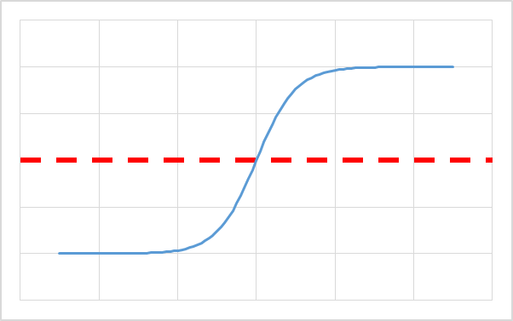
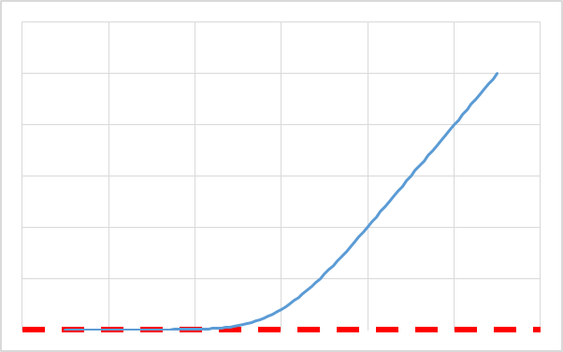
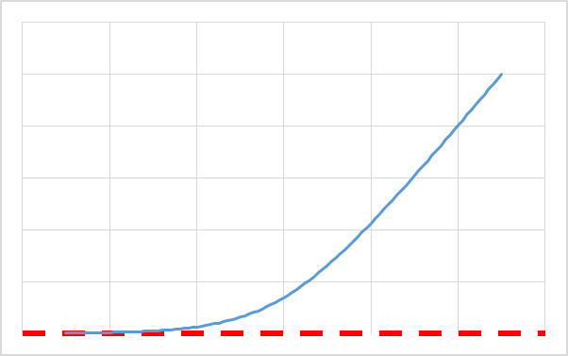
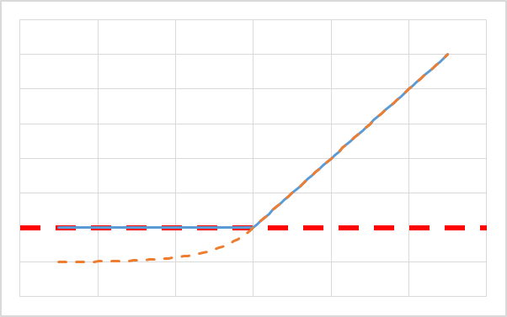
Activations
The hidden activation function g must be non-linear – here are the most common choices :
*antisymmetric around zero, saturates slowly on the sides default choice is ELU
Context | Intuitive solution | Cheaper computation | Improves training*
Activate localized spheres Application: interpolation/spline | Gaussian density | Derivative of sigmoid
Activate above threshold Application: probability/classification/ flat extrapolation | Gaussian distribution | Sigmoid | Hyperbolic tangent
Activate proportionally to distance to threshold Application: regression with linear extrapolation | Integral of Guassian (Bachelier) | SoftPlus = Integral of sigmoid | RELU / ELU
derivative
integral

Slide 39
Computation graph and complexity
Input layer l=0
Hidden layer l=1
Output layer l=2
Complexity
To the leading order (ignoring activations and additions) We have 2 matrix by vector products
Hence quadratic complexity
To simplify when all layers have n units, complexity ~
More generally, with L layers, complexity ~
Complexity is linear in layers, quadratic in units
feed-forward equation

Slide 40
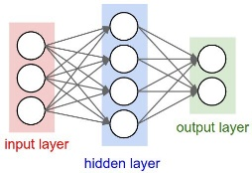
Perceptron: summary
Prediction
Predict target y by linear regression on a set of features a of the input x (of dimension ):
The features are not fixed, they are parametric functions of x, with learnable parameters:
The most common form is the Perceptron:
Features are combinations of inputs, activated element-wise:
Computational benefits: matrix operations faster than the sum of their operations on modern hardware
Universal Representation Theorem: can asymptotically represent any function
Historical legacy and some similarity with how human brain works
Both feature extraction x→a and regression a→y are instances of the feed-forward equation:
The learnable parameters of the network are all the connection weights (linear coefficients) in the extraction and regression steps:
Matrices of weights in dimension
Vectors of biases in dimension
The computation graph is of the familiar shape
The complexity is
dominated by matrix by vector products
linear in layers, quadratic in units

Slide 41

Perceptron: training
Fitting the parameters of the perceptron (also called “training” or “learning” in ML lingo)
Given a “training set” of m training examples, each with an input vector x and a known target y (hence, “supervised learning”)
Set all learnable parameters to minimize prediction errors
Note that learnable parameters are no longer limited to regression coefficients, they also include weights of feature extraction
Learnable parameters are all the connections between units of successive layers
They are represented by the edges of the computation graph
Formally, they are the union of matrices W (and biases b) in the sequence of feed-forward equations
So we are looking for the solution of
Or, cancelling gradients: --- unfortunately:
The solution is no longer analytic, a numerical minimization procedure is necessary
C is not even convex in W and b, so the gradient equation has many solutions, corresponding to saddle points and local minima
There exist no algorithm guaranteed to converge to the global minimum The best we have is guarantee of convergence towards a local minimum Incredibly, this is good enough in practice in many cases of practical relevance

Slide 42
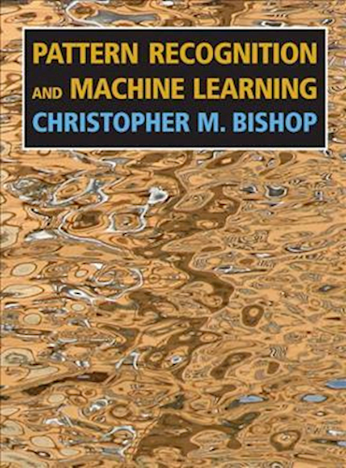
More on regression, basis functions and ANNs

Slide 43
Batch prediction
Single example prediction sequentially applies the feed-forward equation
from vector of inputs to output
To predict multiple examples 1,...,m we could:
Sequentially run feed-forward equations with to find , then with to find , etc.
Or, we could run feed-forward equations once with (stacking examples in columns)
to find (with results also stacked in columns)

Slide 44
Batch prediction (2)
Feed-forward equations remain absolutely identical
as are now matrices, stacking batches of examples in column vectors
Adding a vector v to a matrix M means: add v to all columns of M This is called “broadcasting” in programming languages Implemented by default in Python’s numPy But not in C++
Why implement batch prediction?
Complexity is identical: to process a matrix product at once or as a set of matrix by vector products, column by column, is identical
But modern hardware (CPU, GPU, TPU) is highly optimized for SIMD processing
SIMD: Single Instruction, Multiple Data: apply the same instructions to a lot of different data simultaneously
On GPU, (reasonably sized) batch prediction takes a time similar to one single prediction!
In all that follows, for simplicity, we consider single example predictions where as are vectors
All equations apply identically with batch predictions with as matrices with m (batch size) columns
Practical implementations always predict in batches

Slide 45
Deep learning: mechanics
Exactly as before:
Input layer is set to the input vector x:
Successive layers are computed from the previous layer by application of the identical feed-forward equation:
Prediction is the last (output) layer:
The only difference is: we have multiple hidden layers 1, 2, ..., L-1
So the mechanics are identical to before
The more interesting question is: why would we want multiple hidden layers?

Slide 46
Multi-layer perceptron (MLP)
Input layer l=0
Hidden layer l=1
Hidden layer l=2
Hidden layer l=3
Output layer l=4
Prediction: feed-forward equations
Parameters:
Number of parameters:
Complexity
Training: find all to minimise cost
Use iterative algorithms compute all D differentials on each iteration
Key: quickly compute large number D of differentials
feed-forward equation

Slide 47
Deep learning: rationale
Universal Representation Theorem states that all functions are attainable with a single hidden layer
This is an asymptotic result, as the number of units in the hidden layer increases to infinity
In practice, we have a limited “computational budget” so we have only so many units
It has been empirically observed, repeatedly, that:
Given a fixed computational budget
Networks with multiple layers (of fewer units)
Perform (exponentially) better than those with one layer (with more units)
This is the basis of modern Deep Learning
This is not (yet?) formally demonstrated
It is even unclear how to formalize what it is exactly we want to demonstrate?
But deep learning was repeatedly validated by its empirical success
And we can try to explain why with heuristics and intuition if not with formal maths

Slide 48
Learning by composition
The heuristic rationale is:
Deep Learning introduces function composition, allowing nets to represent a larger space of functions with a limited number of units
With one hidden layer:
Each basis function is an activated combination of the input units
So additional hidden units allow the network to learn a larger number of basis functions of the same shape
With multiple layers:
Each unit in a layer is a function of all the units in the previous layer
a1 is a function of a0=x, a2 is a function of a1, etc.
In the end, we regress linearly on the penultimate layer which we call the “basis layer”
Whose units are basis functions of basis functions of basis functions ... of the inputs
So, instead of simply increasing the number of possible combinations of the inputs
Deep nets learn to compose functions to find optimal basis functions for regression
Composition allows them to attain a larger, richer space of functions with a limited overall number of units
Hence, giving nets a higher representational power for a fixed computational budget

Slide 49
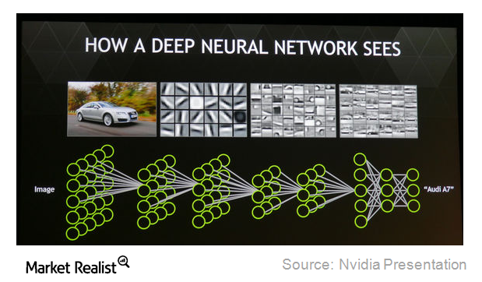
Example: image recognition by deep learning
Early layers detect low level features: mainly, edges, horizontal, vertical, diagonal...
Subsequent layers combine them into more complex features: wheels, windshields, etc.
Late layers combine these into cars The degree of activation of different cars in the output layer gives the probability of identification

Slide 50
Deep learning: rules of thumb
Again, formalism of performance in deep nets is a very active, very challenging topic of current research With no convincing answer at present
But, empirically, deep nets have shown spectacular performance in many fields, including:
Image recognition (with deep “convolutional” nets)
Time series prediction (with deep “recurrent” nets)
Natural Language Processing
And much more
Out of scope in this lecture, see Andrew Ng’s highly recommended Deep Learning Specialization on Coursera
Some rules of thumb were identified:
For regression problems like we have in finance, performance sharply improves from 1 to 3-5 layers, stabilizes thereafter
On the contrary, deep convolutional nets in computer vision typically include hundreds of layers
Network architecture and other “hyper-parameters” (fixed, non-learnable settings like activation functions) are set by trial and error, from experience or costly “cross-validation” tests (means test performance of trained net on a set of examples not in the training set, and pick best hyper-parameters)

Slide 51
Back-Propagation

Slide 52
Elements of multivariate calculus
We will derive the differentials of cost functions in neural nets, and learn an algorithm to compute them extremely quickly
This algorithm, called “back-propagation”, or often “back-prop”, is what enables deep net training in reasonable time
Deep learning would not be feasible without it
Further, we will see that back-prop is a only a particular case of a more general algorithm, applicable to any calculation that computes a scalar result from a (large) vector of inputs and/or parameters called “adjoint differentiation” (AD)
Modern frameworks apply back-prop and AD automatically, behind the scenes
In its most general form, this is called AAD: the first A stands for Automatic
Since practical neural nets are sequences of matrix operations: matrix product and element-wise activation
We have to apply matrix differential calculus
Hence, we (briefly) introduce a few results we need to derive basic back-prop, for a more complete reference, see:
Mathematics for Machine Learning by Imperial College on Coursera

Slide 53
Gradients
Consider a scalar function of a vector:
We call gradient of f on x and denote the column vector of its derivatives:
Key property of the gradient is: the gradient vector gives the direction where the slope of f is steepest
Demonstration: to the 1st order Hence, for a fixed step size - steepest ascent is in the direction of cos=1 - steepest descent is in the direction of cos=-1 - f is unchanged moving orthogonally to cos=0
This key property is the basis of most optimization algorithms
derivatives in rows
function in column
steepest descent
f(x)
f unchanged
x
steepest ascent

Slide 54
Matrix gradients
The gradient of f(x) has the same shape (nx1) as x
We want the same property for scalar functions of matrices:
We denote the matrix of its derivatives, of the same shape (nxp) as M

Slide 55
Jacobians
Consider a vector function of a vector (or a set of p functions of x, x being of dim n)
The matrix of the derivatives of the p functions to the n inputs is called Jacobian matrix
Conventionally, Jacobians are often written with functions in rows and derivatives in columns:
This is inconsistent with gradients, written the other way Hence, confusing
In this case, is of shape (pxn)
And you can check that the chain rule is written: (outer function first)
functions in rows
derivatives in columns

Slide 56
Jacobians the other way
We will write Jacobians the other way, consistently with gradients:
This is consistent with gradients
Gradient = Jacobian of one-dimensional functions
Jacobian = horizontal concatenation of gradients
In this case, is of shape (nxp)
And you can check that the chain rule is written: (inner function first)
derivatives in rows
functions in columns

Slide 57
Jacobians of linear functions
If is linear, i.e. where A is a matrix of shape (pxn)
Then, you can convince yourself that its Jacobian matrix (with derivatives in rows) is the constant:
and not A (which is maybe why people like Jacobians the other way around…)
=
*

Slide 58
Jacobians of element-wise functions
Consider a scalar function:
We apply f element-wise to a vector x of dim n to obtain another vector of dim n:
Then, the Jacobian of f is the nxn diagonal matrix of element-wise derivatives:
=

Slide 59
Vector functions of matrices
Consider now a vector function of a matrix:
In principle, its “derivative” is a 3D tensor of shape (nxpxq):
In the linear case where , and v is a constant vector of size p=q
We have and
Or, more compactly:
=
*

Slide 60
How to train your network
Recap: we have an ANN of the MLP form implementing the following sequence of feed-forward computations:
Starting with inputs
Sequentially compute then (for l = 1, 2, ..., L: feed-forward equations)
To make predictions
We also have a training set of m independent samples for the inputs x (each in dim n0), along with corresponding labels
We want to train the ANN so its predictions are the “best” predictions for y knowing x, that is
By definition, conditional expectation is the function closest in the sense of least squares:
And we know/have seen that:
(given enough height and depth) the ANN can represent any function f to arbitrary accuracy by adjusting its parameters W and b
(given enough training examples) where ci is the quadratic loss of example i
Therefore, we must find the parameters W* and b* minimizing mean square prediction error on the training set:

Slide 61
Bad news good news
There is no analytical solution for the optimal weights (unlike with linear regression)
The cost C is a non-convex function of the weights W biases b (in what follows we just call “weights” all the parameters)
An algorithm guaranteed to find the minimum of a non-convex function does not exist, and probably never will
So, the problem of training ANNs cannot, in theory, be resolved
This realization caused mathematicians to step away from deep learning in the 1990s
Deep learning was revived recently by engineers along the lines of “this is not supposed to work, but let’s try anyway and see how we can take it”
And we all know it did work and produced spectacular results
The starting point is gradient descent:
Choose initial weights randomly
Take repeated steps, changing weights
by a small amount called “learning rate”
along the direction of steepest descent, which we know is the direction opposite to the gradient
Many heuristic improvements were made to improve and accelerate learning, but none is guaranteed to converge
However, we understand the intuitions and take comfort in that they work remarkably well in a multitude of contexts

Slide 62
Differentials by finite differences
Optimization algorithms
All learning algorithms start with a random guess and make steps according to the current gradient
Our job is compute the gradients and of the cost C, repeatedly
Our goal is to do it quickly
Gradients by finite differences (FD):
First compute the cost with the current weights, making predictions for all training examples
To compute the sensitivity of the cost to each scalar weight or bias :
Bump the parameter by a small amount
Re-compute the cost , repeating feed-forward calculations for all training examples
The derivative to the bumped weight is approx.
FD is (obviously) linear in the (potentially immense) number of weights, therefore not viable
But it has very desirable properties

Slide 63
Automatic derivatives with FD
Implementation is straightforward with little scope for error
Importantly, FD differentiation is automatic
Developers only write prediction (feed-forward) code
FD computes differentials automatically by calling the feed-forward code repeatedly
Developers don’t need to write any differentiation code
More importantly, FD automatically synchronises with modifications to feed-forward code
Tricks of the trade (see e.g. Coursera’s Deep Learning Spec) to train deep nets faster and better:
Regularization: add a regularization term to cost function
Dropout: randomly drop connections between units
Batch Norm: normalize the mean and variance on all layers
And many more
All of these modify feed-forward equations and code, and affect differentials
With manual differentiation, developers must consistently recode differentiation accordingly
This is painful and prone to error
With automatic differentiation, differentiation automatically remains consistent with evaluation

Slide 64
Analytic differentials in MLPs
FD is a general, automatic differentiation algorithm but it is too slow for training ANNs
Lets see if we can do better with analytic differentiation, specifically and manually, for ANNs only
We will derive analytic differentials for linear regression first
Then, generalize to shallow neural nets, with a single hidden layer
Finally, generalize to vanilla deep nets
Later, we will generalize to any kind of network and any scalar computation
And see how to compute differentials automatically, behind the scenes, like with FD, but an order of magnitude faster

Slide 68
Manual derivatives with AD
Recall the sequence of calculations in the network:
We want to (quickly) compute all the
Where the cost is the mean of the losses in the training set: so
We derive the derivatives of one loss c (dropping its index i in the training set) and sum them up in the end
By the chain rule: and is known:
So we can first compute all the , and then, apply the equation above to find all the

Slide 69
Manual derivatives with AD (2)
Still from the chain rule, we see that:
Note that this is the adjoint equation for the adjoints
Therefore, we can calculate all the (adjoints) :
where we recall that all the are known, we “just” need to compute their matrix products

Slide 70
Manual derivatives with AD (3)
We have our formula:
And we know that so “two prediction errors”, which we recall is a real number
We must compute for every layer l, where we recall that all the are known from:
The architecture of the network, which gives the form all the vector functions ϕ, hence, also their Jacobians
The parameters θ on the current iteration
The activations a computed while making predictions (prior to computing derivatives, we must compute the predictions and store all the activations on all the layers)
What is the most efficient way to compute this matrix product knowing all the matrices in the product?

Slide 71
Manual derivatives with AD (4)
For example, let us compute the derivatives to the 1st layer:
We could compute it left to right, layer 1 to layer L, in the order of the feed-forward equations
Or, we could compute it right to left, layer L to layer 1, in the reverse order
Note that and are real numbers, so the rightmost term is also a real number
and the second rightmost term is a vector of dim , the gradient of the prediction to the basis functions in the final hidden layer
All the other terms are matrices of shape
Crucially, the result is a vector (of dim n1) because the loss c is scalar

Slide 72
Manual derivatives with AD (5)
forward calculation
So:
Forward calculation:
Start with a matrix
Repeatedly multiply matrices by matrices to obtain matrices, which is of cubic complexity
Collapse to a vector by right multiplication with a vector on the final hidden layer
Backward calculation:
Start with a vector
Repeatedly multiply matrices by vectors to obtain vectors, which is of quadratic complexity
Backward calculation is one order of magnitude faster!
backward calculation

Slide 73
Back-propagation algorithm
Back-prop: algorithm to compute derivatives in the reverse order, one order of magnitude faster
Algorithm:
Compute prediction by feed-forward through the network, storing all hidden activations al
Compute the adjoints of all the layer activations in the reverse order
Start with
Recursively compute from layer L-1 to layer 1
Note we get all the in a single backward sweep, computing them all from one another
Also recall the Jacobian matrices are known from the architecture, current weights and pre-calculated activations
Compute the desired derivatives where, again, is known

Slide 74
Back-propagation = AD
The core of back-prop is the recursive reverse equation:
We have seen this equation before and called it adjoint equation
Back-prop is the application of the adjoint equation to neural nets
Back-prop (also called AD) is not limited to neural nets
It is applicable to any calculation as long as:
The final result is scalar, so adjoints are vectors and not matrices
The computation is organized in layers, where every layer is a known function of the previous layer only
We will see that any computation can be organized in layers, this is called the computation graph
So back-prop (AD) is applicable to any computation, as long as the final result is scalar
And it always computes all adjoints (derivatives) in a single (backward) sweep through the calculation graph

Slide 75
Back-propagation through MLPs
MLP is a particular case where:
It is convenient to split each layer in two: a linear combination followed by an activation:
And we have the adjoint equations in the reverse order:
Where and are given by a direct application of matrix calculus (see next slide)
scalar activation function for layer l applied element-wise
vector of biases for layer l
matrix of weights for layer l

Slide 76
Back-propagation through MLPs (2)
feed-forward
back-prop
from matrix calculus
where denotes element-wise product
and finally (also from matrix calculus) we have the sensitivities to weights from the sensitivities to activation:
because:

Slide 77
MLP back-propagation algorithm
Which gives us the MLP back-prop, generally described in literature and implemented in frameworks
Algorithm:
Compute prediction by feed-forward through the network, storing all hidden combinations zl and activations al
Compute the adjoints and of all the layer combinations and activations in the reverse order
Start with
Recursively compute and then from layer L-1 to layer 1
Compute the desired derivatives and of loss to weights and biases

Slide 78
Back-propagation: complexity
Recall the leading complexity of feed-forward is a matrix by vector product by layer of quadratic complexity in the number of units
We need a prior feed-forward before back-prop to compute and store all the zl and al
The back-prop equations are executed once on every layer (in reverse order) to compute derivatives to activations and weights:
is of linear complexity (element-wise multiplication of two vectors)
is of quadratic complexity (matrix by vector product)
is of quadratic complexity
is immediate

Slide 79
Complexity and memory considerations
So the complexity of a complete back-prop to compute all derivatives is 3 times the complexity of a feed-forward prediction:
One necessary feed-forward prediction to compute and store all the zl and al
The back-propagation itself takes one matrix by vector product, quadratic in units, like feed-forward (but in reverse order)
Finally, the computation of derivatives to weights adds another matrix by vector product on each layer
As promised, we compute a large number of derivatives in constant time
The actual back-prop is as fast as one prediction (the other 2 are for the prior prediction and derivatives to weights)
Independently on the number of derivatives
It works because:
The end result is scalar, so its derivatives to vectors are vectors
Reverse adjoint propagation collapses matrix by vector products into vectors, so we have quadratic complexity, like feed-forward
Derivatives are computed analytically in one sweep, there is no need to repeatedly bump many parameters one by one
It consumes significant memory
All combinations and activations must be stored for all layers
In addition to all the weights and biases

Slide 80
Automatic backprop?
Reverse adjoint propagation
Also called back-propagation or back-prop in ML lingo, or adjoint differentiation (AD) in general
Computes all differentials of the cost to the many parameters in a deep net in a time similar to one evaluation of the cost
Achieves this remarkable result by reversing the order of the calculations in the differentiation
Is the only viable means to train deep nets in reasonable time
Relies on the cost being scalar, hence its adjoints are vectors
Applies to any scalar calculation, not just neural nets
However manual AD code is
Complicated and prone to error
Painful to maintain and synchronize as we modify feed-forward code
AAD: automatic adjoint differentiation
Next, we learn to automate AD
Since AD propagates adjoints in the reverse order through evaluation graphs
We will learn to automatically generate graphs so we can back-prop derivatives through them
Not only for deep nets, but for any calculation
Including large Monte-Carlo simulations
First, we illustrate the application of deep learning to financial derivatives

Slide 81
Deep learning in finance

Slide 82
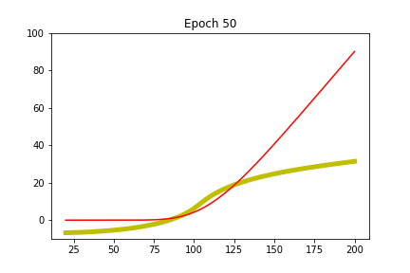
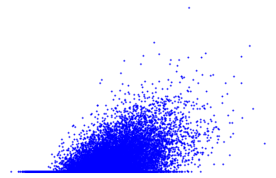
Example: learn Black-Scholes from data
We reuse the same example as for linear and quadratic regression
Simulate data for the spot in 1y and a call payoff in 2y
Train a neural net to find the future price of the call in 1y as a function of the spot prevailing in 1y
See if it can learn Black & Scholes from data alone
max(S2-K,0)
S1
The net learns Black & Scholes from the data cloud alone
The red line (Black & Scholes’s formula) is only for the viewer’s reference
The net doesn’t know anything about Black & Scholes at any stage

Slide 83
Simple ANNs with TensorFlow
TensorFlow
Machine learning framework open sourced by Google
The most popular framework for machine learning and deep learning
What is TensorFlow exactly?
Another math/numerical/matrix library with API in Python
With 3 perks (in increasing order of perkness)
High level functions to work with ANNs easily and conveniently
Matrix calculus executed on multi-core CPU and GPU
Built-in back-prop so TF computes derivatives of your code, in constant time, behind the scenes (a form of AAD)
Working with TensorFlow
To do all this, TF needs to know computation graphs: all computations with order and dependency, before they are executed
Hence, working with TF is surprising at first, you must:
First “register” the calculations with TF, that is, build the graph in TF’s memory space
Then, ask TF to run the graph, and back-prop through the graph when derivatives are needed

Slide 84
Simple example walkthrough
Head to http://GitHub/asavine/CompFinance/Workshop/
Run the notebook dlBlackScholes.ipynb (TensorFlow must be installed)
This notebook demonstrates
The (basic) operation of TensorFlow
How to build and train (simple) neural nets in practice
Application to financial derivatives (revaluation)
How to implement a simple example in Black & Scholes
max(S2-K,0)
S1

Slide 85
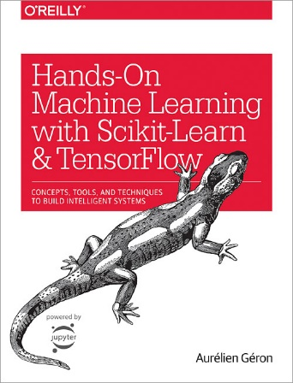
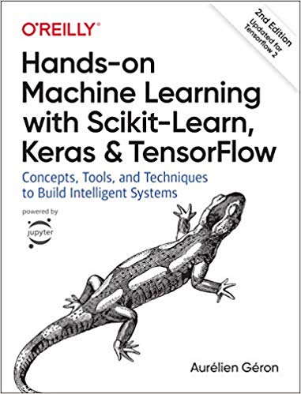
Learning TensorFlow
Summer 2019

Slide 86
Revaluation nets
What we just saw is a (very simple) example of a revaluation problem: What is the future value in simulated scenarios of a derivatives transaction or book of transactions?
Vast domain of application:
Pricing callable options and exotics with Monte-Carlo
Simulate state variables up to the exercise date
Apply the net to find the continuation value on the exercise date
Determine if the call is exercised or not in this scenario
Extension of the well-known “Least Square Method” of Longstaff-Schwartz and Carriere (late 1990s) to modern deep learning
More importantly, regulatory simulations like XVA, MVA, CCR or FRTB
Simulate the future value of derivatives books in a large number of scenarios to compute exposures
Normally require nested simulations (MC to estimate book value inside MC to simulate market to exposure date!)
Revaluation nets offer alternative orders of magnitude faster and more accurate
Read the intro of the notebook in http://GitHub/asavine/CompFinance/Workshop/dlBlackScholes.ipynb

Slide 87
Revaluation nets (2)
Revaluation nets are disposable
Trained for a given set of transactions in a given model, calibrated to current market data
Market, model and transaction parameters get encoded in the weights of the network
Only input is simulated state vector
The input is only valid with the market, model and transaction it was trained with
Revaluation nets are trained once, used once
Hence, training must be very fast (seconds)
Revaluation nets are very general, work with models and transactions of any complexity
Revaluation nets resolve key problems with regulatory simulations, in particular XVA, FRTB, CCR and MVA
Upcoming article “Deep Analytics” by Brian Huge and Antoine Savine

Slide 88
Pricing nets
An apparently similar problem is pricing
Context:
Given a dynamic model with a number of parameters
Current market: asset prices, interest rates, etc.
Dynamic parameters: volatilities, volatilities of volatilities, correlations, etc.
Not an exotic model a la Dupire with vast (term structures) of parameters
But a European model a la SABR/Heston/RoughBergomi with a limited number of parameters
And some transaction, also with a number of parameters
Generally, European option or first order exotic (barrier) with few parameters like expiry, strike, barrier
Pricing problem:
Only simplest models like Black & Scholes have explicit closed form solutions
More realistic models require
Expansions/approximations (SABR/ZABR)
Numerical integration (Heston)
Multi-Factor FDM
Slow Monte-Carlo simulations (RoughVol)

Slide 89
Pricing nets (2)
Can we do better with a neural net?
Generate a vast training set, sampling the space of all market, model and transaction parameters
For each sampled parameter set, produce a price, e.g. with Monte-Carlo simulations
Note the training set alone may take hours or days
Train a neural net to generalize pricing from the training set
Apply the trained net as a very fast, very accurate ~almost closed form~ pricer
Train once, use forever
Very different from reval nets
Train on prices, not realizations: training set is sampled, not simulated (sampling correctly is perhaps the major challenge)
May train for hours or days, forever reusable
Weights only encode pricing mechanics. Market, dynamic and transaction parameters are inputs
One net per model (e.g. McGhee’s SABRNet for SABR or Horvath and al’s RoughNet for RoughBergomi)
Limited to European models and transactions, not likely to extend to exotics

Slide 90
Pricing nets (3)
Recent results
McGhee (2018) built a SABR net, more accurate than Hagan’s approximation and orders of magnitude faster than 2D FDM
Ferguson and Greene (also 2018) built a net for pricing basket options with parameters (inputs) including correlation
Horvath and al. (2019) built a net for pricing with Rough Volatility
This is particularly significant
Because there exist no alternatives for pricing with rough vol other than slow Monte-Carlo
RoughNet therefore opens new applications for calibration, pricing and risk management with rough vol
So far, rough vol was restricted to academic circles due to absence of fast pricing, it may now enter production

Slide 91
Deeper learning for financial derivatives
 | Reval nets | Pricing nets
Output | Future price depending on scenario | Current price
Inputs | Simulated state variables | Market, model and transaction parameters
Training set | State variables to payoffs = realizations per scenario | Model parameters to prices = expectations across scenarios, per parameter set
Weight encoding | Valuation mechanics + market, model and transaction parameters | Valuation mechanics only
Applications | Callable exotics with MC XVA, MVA, FRTB, CCR, etc. | Europeans and first order exotics Stochastic volatility/rough vol/jump/etc. Calibration/pricing/risk management
Reuse | Disposable | Reusable
Model and transaction scope | Any complexity | Restricted to Europeans and simple exotics
Accuracy requirement | Medium | High
Training time | Seconds | Hours
Reference nets | DeepAnalytics (Huge & Savine, coming 2019) | McGhee’s SABRNet (2018) Ferguson & Greene’s BasketNet (2018) Horvath and al’s RoughNet (2019)

Slide 92
Deeper learning
We studied in detail the fundamental machinery of feed-forward and back-propagation
There is a lot more to deep learning:
Speed and accuracy improvements: regularization, dropout, batch-norm, stochastic gradient descent, etc.
Convolutional nets with many impressive applications in computer vision
Recurrent nets with many impressive applications in natural language processing (NLP) And also time series forecasting, proprietary trading strategies, etc.
Reinforcement learning, leveraging DL to learn strategies for playing games, driving cars or trading currencies
Deep learning is here to stay
Overhyped due to recent successes in computer vision, NLP and chess/go --- hype will fade
This being said, DL genuinely offers efficient, elegant solutions to otherwise intractable problems in finance and elsewhere
DL will not replace financial models but it will be part of the financial quant toolbox
Financial quants and derivatives professionals cannot ignore it

Slide 93
AD through evaluation graphs

Slide 94
Evaluation graphs and adjoint propagation
Evaluation graph
We have seen evaluation graphs for neural nets
Evaluation graphs express the order and dependencies of “atomic” calculations involved in a larger evaluation
Any evaluation defines a graph
Hence, every evaluation defines a sequence of feed-forward operations, similarly to a neural net
Chapter 9 of the Modern Computational Finance book builds evaluation graphs in memory with operator overloading in C++
Adjoint Differentiation is back-propagation over graphs
Not limited to neural nets, applicable to any evaluation
Propagates adjoints backwards through the evaluation graph
Offers constant time efficiency (all differentials for an expense similar to one evaluation) for scalar calculations (A scalar calculation is one where the final result –or output layer, is scalar)
the step functions g are “building blocks” of calculation, which Jacobians are known --- not activations (we are no longer in DL)
Feed-forward to compute results:
(compact form)
evaluation graph
Back-propagate to compute derivatives:

Slide 95
Example: Black & Scholes
Black & Scholes’ formula: with
Discount factor to maturity:
Forward:
Standard deviation:
Log-moneyness:
D’s:
Probabilities to end in the money, resp. under spot and risk-neutral measures:
Call price:

Slide 96
Black & Scholes: evaluation graph
Inputs
Temp. calc.
Temp. calc.
Temp. calc.
Temp. calc.
Result
Input layer l=0
Hidden layer l=1
Hidden layer l=2
Hidden layer l=3
Hidden layer l=4
Output layer l=5

Slide 97
Feed-forward equations
As in deep nets, for any calculation, we have the feed-forward equation defining the evaluation graph:
In Black & Scholes, we have the steps:

Slide 98
Back-prop equations
For any calculation, where we compute the differentials of the result to the inputs:
If we split the calculation into elementary pieces g, we know the Jacobians
In Black & Scholes
Note that the Jacobian of the output layer is a vector, as with any scalar calculation

Slide 99
Back-propagation algorithm
We have identified the calculation graph with all its steps g and their Jacobians g’
We have run it once and stored all the intermediate results a
We can compute all the derivatives of in constant time by back-prop:
Not that interesting with Black & Scholes: only 6 inputs/derivatives: delta, vega, rho, …
The exact same equations apply with large evaluations taking 6,000 inputs --- very interesting then
Left as an exercise: Show that Black & Scholes’ Jacobians of the previous slide lead to the well known Black-Scholes “Greeks”

Slide 100
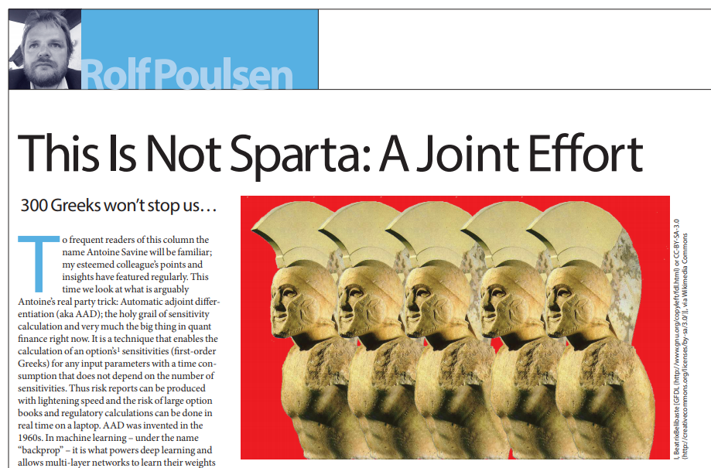
“Atomic” building blocks
What we just did is:
Split a calculation
Into a sequence of simpler calculations
Then, we applied back-propagation to compute derivatives
Pushing this logic to limit, we can:
Split any calculation into a sequence of “atomic” building blocks: +, -, *, /, pow(), exp(), log(), sqrt(), sin(), cos(), …
Note that we have a very limited number of building blocks (about 20 in total)
And, yes, any numerical calculation is, always, a (long) sequence of these 20-something building blocks!
This is another mind-twisting fact, see Rolf Poulsen’s Wilmott article: antoinesavine.files.wordpress.com/2018/12/poulsen-2018-wilmott.pdf
For these 20-something building blocks, we know the derivatives g’ : exp’ = exp, log’ = 1/x, sqrt’ = 1 / 2sqrt, etc.
Therefore, we can code these 20-something derivatives once and for all, and automate back-prop ➔ this gives us AAD

Slide 101
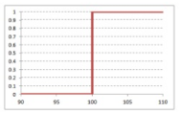
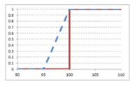
Control flow
It is a somewhat vertiginous realization that any calculation, like the Monte-Carlo estimate of the counterparty credit value adjustment on a netting set of thousands of exotic transactions, is still a sequence of elementary operations. A very, very long sequence, but a sequence all the same.
Rolf Poulsen
Mathematical equations are more than sequences of building blocks We also have limits, differentials, integrals, etc.
But their numerical implementation is always nothing more, nothing less than a sequence of building block operations…
… and control flow, also called branching: “if this then that” statements
Control flow makes functions discontinuous, hence, not differentiable
Attempts to differentiate control flow with bumping results into instabilities
AD/AAD computes exact differentials – same as infinitesimal bumps
So derivatives are always taken on the same side of the control flow, and not through control flow
This is not always the desired result, so something to take into account
The solution is smoothing, see https://www.slideshare.net/AntoineSavine/stabilise-risks-of-discontinuous-payoffs-with-fuzzy-logic
f(x) = 1 if x > 100, else 0
after bump
before bump
after bump
before bump
before bump
after bump
Smoothing
Approx f by close continuous func
Instabilities/incorrectness vanish

Slide 102
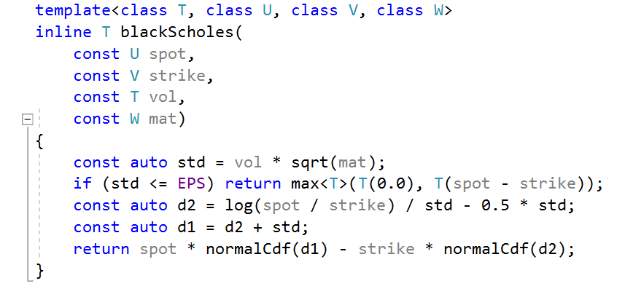
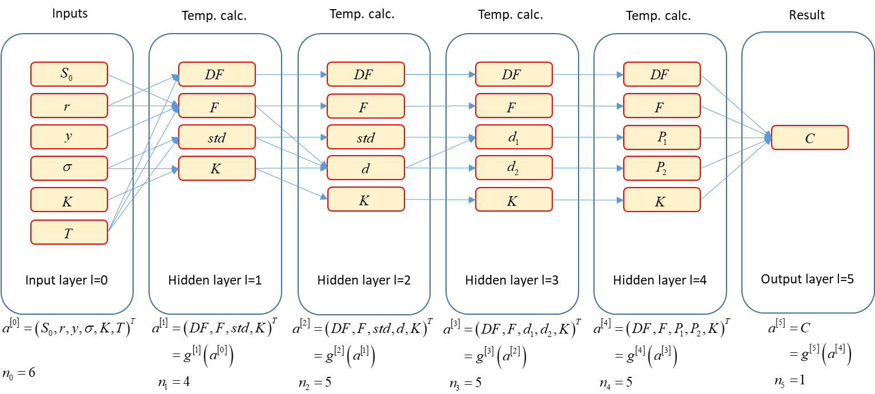
Conclusion
All calculations define a graph, down to 20-something “atomic” building blocks gs
Like deep nets, all evaluation graphs may be arranged in successive layers, each an elementary function g of the previous one (which Jacobians are known):
Once the evaluation graph and its steps g are known, along with their Jacobians g’ (and the graph was run once so intermediate results a were stored)
All derivatives can be computed in constant time by back-prop
If we can automatically produce a graph from a code, then we can automate the whole process
AAD
we don’t know yet how to do that
back-prop (AD)
we know this already
all derivatives,
analytic and in constant time
code
graph

Slide 103
Recording calculations on tape

Slide 104
C++ code
From there on, we work with C++ code
We only work with simplistic, beginner level C++
We show that we can still implement AAD with rather spectacular results
We refer to the Modern Computational Finance book for a professional, generic, parallel, efficient implementation
All the code is freely available on GitHub, in the file toyCode.h
https://github.com/asavine

Slide 105
Automatic differentiation
Differentiation by finite differences
Computes derivatives by running evaluation repeatedly
Only requires executable evaluation code
Linear complexity in the number of differentials
AAD
Computes derivatives by running AD in reverse order over an evaluation graph
Requires a graph to traverse – executable code is not enough
Constant complexity in the number of differentials : fast differentiation of scalar code
To implement AAD we must extract an evaluation graph: sequence of calculations (nodes) and their dependencies (edges)

Slide 106
Building evaluation graphs
Explicit evaluation graphs
Solution implemented in TensorFlow
Lets users explicitly build graphs by calling graph creation functions exported to many languages
Then ask a TensorFlow session to evaluate or differentiate the graphs efficiently: evaluation and AD, on multicore CPU or GPU
Smart and efficient
But forces developers to explicitly build graphs in place of calculation code
(TensorFlow has a nice API that makes building graphs somewhat similar to coding calculations)
But what we want here is take some calculation code and automatically extract its graph
Source transformation
Code that reads and understands evaluation code, then builds graphs and writes backward differentiation code automatically
Complex, specialized work similar to writing compilers
Variant: template meta-programming and introspection (introduced in chapter 15)

Slide 107
Operator overloading
Alternative: operator overloading (in languages that support it like C++)
When code applies operators (like + or *) or math functions (like log or sqrt) to real numbers (double type) the corresponding operations are evaluated immediately (or eagerly):
When the same operators are applied to custom types (our own type to store real numbers) we decide exactly what happens:
double x = 1, y = 2; // x and y are doubles
double z = x + y; // evaluates x + y and stores result in z
double t = log(x); // evaluates log(x) and stores result in t
class myNumberType
{
// class definition here
};
myNumberType operator+(const myNumberType& lhs, const myNumberType& rhs)
{
// this code is executed anytime two numbers of type myNumberType are added
}
myNumberType log(const myNumberType& arg)
{
// this code is executed anytime log is called on a number of type myNumberType
}
myNumberType x, y; // x and y are of type myNumberType
myNumberType z = x + y; // executes code in the overloaded operator+()
myNumberType t = log(x); // executes code in the overloaded log()

Slide 108
Recording operations
We apply operator overloading to record all operations along with their dependencies:
class myNumberType
{
myNumberType(const double x)
{
// constructor initializes value to x and records node
}
};
myNumberType operator+(const myNumberType& lhs, const myNumberType& rhs)
{
recordAddition(lhs, rhs); // records addition with dependency on lhs and rhs
}
myNumberType log(const myNumberType& arg)
{
recordLog(arg); // records log with dependency on arg
}
myNumberType x = 1, y = 2; // initializes x to 1 and y to 2 and records them
myNumberType z = x + y; // records addition with dependencies on x and y
myNumberType t = log(x); // records log with dependency on x
myNumberType result = t + z; // records addition with dependency on t and z

Slide 109
Lazy evaluation
When this code is executed:
Nothing is calculated, instead the following graph is recorded in memory:
This sequence can be evaluated later (lazy evaluation) or differentiated (applying AD from back to front)
This is how we build the evaluation graph at run time, by executing calculation code with a custom type for which operators are overloaded to perform recording
myNumberType x = 1, y = 2; // initializes x to 1 and y to 2 and records them
myNumberType z = x + y; // records addition
myNumberType t = log(x); // records log
myNumberType result = t + z; // records addition
value 1
value 2
+
log
+
x
y
z
t
result

Slide 110
Conventional implementation
We introduce the conventional implementation of AAD
Where every math operation: +, -, *, /, pow, log, exp, sqrt, … is recorded on a data structure called tape
(It is really an evaluation graph but we call it “tape” in AAD lingo)
Cutting-edge implementation records whole expressions
With template meta-programming and expression templates
Resulting in 2x to 5x faster code
Sometimes called “tape compression”
Extreme instance: “tapeless AD” where we don’t record anything!
All implemented in professional code on GitHub and explained in detail in chapter 15
In this presentation, we stick with simpler, conventional implementation
We record every mathematical operation involved in a calculation
Every calculation, up to complex Monte-Carlo simulations, is a sequence of +, -, *, /, pow, log, exp, sqrt, … !
We record every single one
Note that all operations have either 0, 1 or 2 arguments

Slide 111
Simplistic implementation
In this presentation, we focus on the simplicity of the code
We use basic C++ code and disregard efficiency, scalability and best practice
Our aim is to explain the key ideas with simplistic code
This code works, just not efficiently
In the book, on the contrary, we build professional, scalable, efficient code in modern C++
This is particularly important for AAD because of:
Recording overhead
Every addition, multiplication, etc. produces a record
Recording necessarily involves an overhead
An efficient implementation must minimize overhead and make recording as efficient as possible
Vast memory consumption
We store in memory all the operations involved in a large calculation, this is a very large number of records
Estimated RAM consumption around 5GB per second
Efficient memory and cache management are key to an efficient implementation
An efficient implementation of conventional AAD is given and explained in chapter 10
Effective, custom memory management
Recording with minimum overhead, cache efficiency and so on

Slide 112
Record and tape data structures
A record
Stores one operation
Knows the number and location of the 0, 1 or 2 arguments
Stores the 0, 1 or 2 partial derivatives to its arguments so we can apply AD
The tape stores the sequence of records
struct Record
{
int numArg; // number of arguments: 0, 1 or 2
int idx1; // index of first argument on tape
int idx2; // index of second argument on tape
double der1; // partial derivative to first argument
double der2; // partial derivative to second argument
};
// The tape, declared as a global variable
vector<Record> tape;

Slide 113
Custom real number
Our custom number
Holds its value and
Knows the index of the corresponding operation on tape
May be initialized with a value to create a record (without arguments) on tape
We overload all mathematical operators and functions to:
Evaluate and store result as usual
Additionally, record the operation and its derivatives on tape
So code is evaluated and recorded at the same time
Number operator+(const Number& lhs, const Number&rhs)
{
// create a new record on tape
tape.push_back(Record());
Record& rec = tape.back();
// compute result
Number result;
result.value = lhs.value + rhs.value; // calling double overload
// reference record on tape
result.idx = tape.size() - 1;
// populate record on tape
rec.numArg = 2;
rec.idx1 = lhs.idx;
rec.idx2 = rhs.idx;
// compute derivatives, both derivatives of addition are 1
rec.der1 = 1;
rec.der2 = 1;
return result;
}
struct Number
{
double value;
int idx;
// default constructor does nothing
Number() {}
// constructs with a value and record
Number(const double& x) : value(x)
{
// create a new record on tape
tape.push_back(Record());
Record& rec = tape.back();
// reference record on tape
idx = tape.size() - 1;
// populate record on tape
rec.numArg = 0;
}
};

Slide 114
Operator overloading
Number operator*(const Number& lhs, const Number&rhs)
{
// ...
// compute value
result.value = lhs.value * rhs.value;
// ...
// compute derivatives
rec.der1 = rhs.value;
rec.der2 = lhs.value;
// ...
}
Similarly, we overload -, *, and /
Same code exactly, only values and derivatives change
Number operator-(const Number& lhs, const Number&rhs)
{
// ...
// compute value
result.value = lhs.value - rhs.value;
// ...
// compute derivatives
rec.der1 = 1;
rec.der2 = -1;
// ...
}
Number operator/(const Number& lhs, const Number&rhs)
{
// ...
// compute value
result.value = lhs.value / rhs.value;
// ...
// compute derivatives
rec.der1 = 1.0 / rhs.value;
rec.der2 = - lhs.value / (rhs.value * rhs.value);
// ...
}

Slide 115
On-class operator overloading
We must also overload +=, -=, *- and /=, as well as unary + and -, on class
The final Number class is therefore:
struct Number
{
double value;
int idx;
// default constructor does nothing
Number() {}
// constructs with a value and record
Number(const double& x) : value(x)
{
// create a new record on tape
tape.push_back(Record());
Record& rec = tape.back();
// reference record on tape
idx = tape.size() - 1;
// populate record on tape
rec.numArg = 0;
}
Number operator +() const { return *this; }
Number operator -() const { return Number(0.0) - *this; }
Number& operator +=(const Number& rhs) { *this = *this + rhs; return *this; }
Number& operator -=(const Number& rhs) { *this = *this - rhs; return *this; }
Number& operator *=(const Number& rhs) { *this = *this * rhs; return *this; }
Number& operator /=(const Number& rhs) { *this = *this / rhs; return *this; }
};

Slide 116
Function overloading
Similarly, we overload log, exp, sqrt
We should really overload all standard math functions
Code is identical for all functions, only value and derivatives change
Number sqrt(const Number& arg)
{
// create a new record on tape
tape.push_back(Record());
Record& rec = tape.back();
// compute result
Number result;
result.value = sqrt(arg.value); // calling double overload
// reference record on tape
result.idx = tape.size() - 1;
// populate record on tape
rec.numArg = 1;
rec.idx1 = arg.idx;
// compute derivative
rec.der1 = 0.5 / result.value;
return result;
}
Number exp(const Number& arg)
{
// create a new record on tape
tape.push_back(Record());
Record& rec = tape.back();
// compute result
Number result;
result.value = exp(arg.value);
// reference record on tape
result.idx = tape.size() - 1;
// populate record on tape
rec.numArg = 1;
rec.idx1 = arg.idx;
// compute derivative
rec.der1 = result.value;
return result;
}
Number log(const Number& arg)
{
// create a new record on tape
tape.push_back(Record());
Record& rec = tape.back();
// compute result
Number result;
result.value = log(arg.value);
// reference record on tape
result.idx = tape.size() - 1;
// populate record on tape
rec.numArg = 1;
rec.idx1 = arg.idx;
// compute derivative
rec.der1 = 1.0 / arg.value;
return result;
}

Slide 117
Custom function overloading
Also overload building blocks that are not standard to C++ but frequently applied in applications
In financial application, we use cumulative normal distributions and normal densities all the time
The functions are defined in the file gaussians.h in the repo
We overload here (once again, only change is in value and derivatives):
Number normalDens(const Number& arg)
{
// create a new record on tape
tape.push_back(Record());
Record& rec = tape.back();
// compute result
Number result;
result.value = normalDens(arg.value);
// reference record on tape
result.idx = tape.size() - 1;
// populate record on tape
rec.numArg = 1;
rec.idx1 = arg.idx;
// compute derivative
rec.der1 = - result.value * arg.value;
return result;
}
Number normalCdf(const Number& arg)
{
// create a new record on tape
tape.push_back(Record());
Record& rec = tape.back();
// compute result
Number result;
result.value = normalCdf(arg.value); // calling double overload in gaussians.h
// reference record on tape
result.idx = tape.size() - 1;
// populate record on tape
rec.numArg = 1;
rec.idx1 = arg.idx;
// compute derivative
rec.der1 = normalDens(arg.value);
return result;
}

Slide 118
Avoiding code duplication
The code for all binary operators and for all unary functions is identical
Only values and derivatives are different
This is poor design: If we change something in the logic, we must consistently modify many different functions
In the professional code of chapters 10 and 15 we structure code and apply “policy design” (Alexandresku, 2001) to avoid duplication without overhead
Here, we stick with duplicated code

Slide 119
Comparison operator overloading
Our custom number must do everything a double does
In particular, we must be able to compare two Numbers
Hence, to complete our simple framework, we must also overload comparison operators:
bool operator==(const Number& lhs, const Number& rhs) { return lhs.value == rhs.value; }
bool operator!=(const Number& lhs, const Number& rhs) { return lhs.value != rhs.value; }
bool operator>(const Number& lhs, const Number& rhs) { return lhs.value > rhs.value; }
bool operator>=(const Number& lhs, const Number& rhs) { return lhs.value >= rhs.value; }
bool operator<(const Number& lhs, const Number& rhs) { return lhs.value < rhs.value; }
bool operator<=(const Number& lhs, const Number& rhs) { return lhs.value <= rhs.value; }

Slide 120
Applying the recording framework
Our simple recording framework is complete, see complete code in the GitHub repo, file toyCode.h
We may use it to record calculations
Example: Black and Scholes
inline double blackScholes(
// input layer 0
const double spot, const double rate, const double yield, const double vol, const double strike, const double mat)
{
/* layer 1 */ double df = exp(-rate * mat), fwd = spot * exp((rate - yield) * mat), std = vol * sqrt(mat);
/* layer 2 */ double d = log(fwd / strike) / std;
/* layer 3 */ double d1 = d + 0.5 * std, d2 = d - 0.5 * std;
/* layer 4 */ double p1 = normalCdf(d1), p2 = normalCdf(d2);
/* output layer 5 */ return df * (fwd * p1 - strike * p2);
}

Slide 121
Instrumenting computation code
To record a Black & Scholes calculation, we must call it with our number type
This is called instrumentation
We can replace all doubles by Numbers:
inline Number blackScholes(
// input layer 0
const Number spot, const Number rate, const Number yield, const Number vol, const Number strike, const Number mat)
{
/* layer 1 */ Number df = exp(-rate * mat), fwd = spot * exp((rate - yield) * mat), std = vol * sqrt(mat);
/* layer 2 */ Number d = log(fwd / strike) / std;
/* layer 3 */ Number d1 = d + 0.5 * std, d2 = d - 0.5 * std;
/* layer 4 */ Number p1 = normalCdf(d1), p2 = normalCdf(d2);
/* output layer 5 */ return df * (fwd * p1 - strike * p2);
}

Slide 122
Instrumenting computation code
Better solution: template code on number representation type
Best practice: produce templated code in the first place
To evaluate only, call with doubles as arguments
To evaluate and record code, call with Numbers as arguments
template <class T> inline T blackScholes(
// input layer 0
const T spot, const T rate, const T yield, const T vol, const T strike, const T mat)
{
/* layer 1 */ T df = exp(-rate * mat), fwd = spot * exp((rate - yield) * mat), std = vol * sqrt(mat);
/* layer 2 */ T d = log(fwd / strike) / std;
/* layer 3 */ T d1 = d + 0.5 * std, d2 = d - 0.5 * std;
/* layer 4 */ T p1 = normalCdf(d1), p2 = normalCdf(d2);
/* output layer 5 */ return df * (fwd * p1 - strike * p2);
}
double spot = 100, rate = 0.02, yield = 0.05, vol = 0.2, strike = 110, mat = 2; // initializes inputs
auto result = blackScholes(spot, rate, yield, vol, strike, mat); // evaluates operations
Number spot = 100, rate = 0.02, yield = 0.05, vol = 0.2, strike = 110, mat = 2; // initializes and records inputs
auto result = blackScholes(spot, rate, yield, vol, strike, mat); // evaluates and records operations

Slide 123
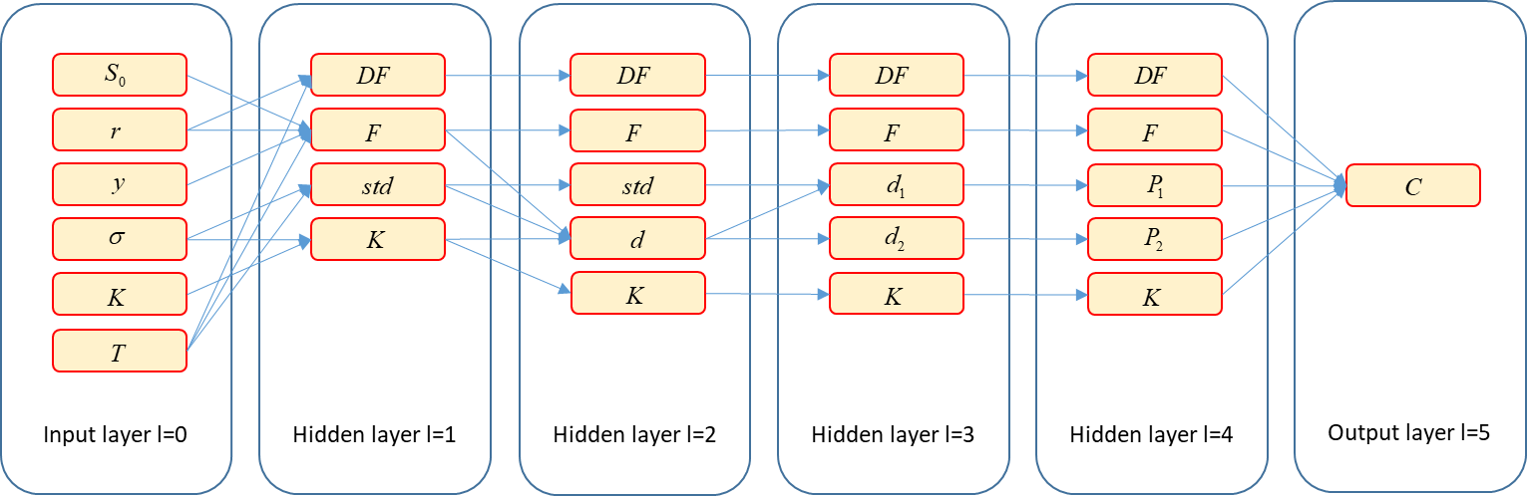
Tape vs graph
Operator overloading gives us a tape of the mathematical operations involved in a calculation
After execution of the templated code for Black & Scholes, we get the following tape:
A tape is not exactly the same as an evaluation graph, where operations are neatly arranged by layer:
Where we recall that operator overloading also gave us:
The operations from ancestors A (arguments) to successors S (results)
And their derivatives

Slide 124
Tape vs graph (2)
The tape and the graph however express the exact same information, differently
We can always turn a tape into a graph or vice-versa
If we had a graph, we could run back-prop to compute all derivatives in constant time
We could turn our tape into a graph, but this would be a waste of precious computational resources
Instead, we work with a slightly different version of the back-prop/AD algorithm
So we can back-propagate adjoints directly through the tape (although it is not arranged in layers)
Using the notions of ancestor (argument to an operation) and successor (result of an operation)
AAD is the sum of a taping framework (e.g. operator overloading) and back-propagation through the tape
Feed-forward to compute results:
Back-propagate to compute derivatives:

Slide 125
AAD

Slide 126
Ancestors
We call the instrumented instance of our code:
Which evaluates the calculation and records all operations on tape
Denote the operation number i, this is a function of 0, 1 or 2 arguments
The arguments must also be on tape, with indices < i
Denote the set of indices of the ancestors (arguments) to - this is a set of 0, 1 or 2 indices, all < i
Denote n the number of inputs and N the number of operations on tape, including inputs
Denote the result of operation i and the final result
Note that all the local derivatives have been computed and recorded on tape, on evaluation, by our operators
Our tape therefore looks like:
Number spot = 100, rate = 0.02, yield = 0.05, vol = 0.2, strike = 110, mat = 2; // initializes and records inputs
auto result = blackScholes(spot, rate, yield, vol, strike, mat); // evaluates and records operations
cout << result.value; // 5.03705
inputs
operations
…
…
…
result
…
…
…
…
…

Slide 127
Successors
Successors: j is a successor to i if i is an ancestor to j
Denote the set of indices of the successors of on tape
These are the indices i of all functions , calculated after that use as an argument
Formally:
Note that may contain many indices, although the size of is 2 or less
Whereas an empty reveals an unused input or intermediate result
Adjoint equation
Denote the adjoint of
Then (evidently):
And in a direct application of the chain rule: because and we recall that all the are all on tape
…
…
…
…
…
…
…
…

Slide 128
Adjoint accumulation V1
Adjoints therefore satisfy a backward recursion
The last adjoint is given
All other adjoints are a weighted sum of future adjoints: for all j
Hence, the following (flawed) algorithm:
Starting with , compute for every j, in the reverse order, from N-1 to 1:
Summing over the successors of xj:
Problems:
Complexity: a node may have many successors to sum over
Impracticality: ancestors don’t store their successors, it is the successors who store their (up to 2) ancestors and partial derivatives
current j
…
…
…
…
…
…
…
…

Slide 129
Adjoint accumulation V2
A more efficient/practical means of computing the same numbers:
The last adjoint is still given
Initialize all other adjoints to 0
Traverse tape in the reverse order, as previously, accumulating the sum from successors
Problems resolved:
Max complexity 2: a node may have up to 2 ancestors
Successors who store their ancestors and partial derivatives
current i
…
…
…
…
…
…
…
…

Slide 130
Adjoint accumulation algorithm
Initialize all adjoints to 0 and the last adjoint to 1 (this is called seeding the tape):
Repeat for i iterating backwards from N to 0:
The differentials of the calculation to its inputs are, by definition,
This algorithm is called (reverse) adjoint propagation
AAD is the sum of a recording framework and an implementation of adjoint propagation

Slide 131
Adjoint accumulation code
vector<double> calculateAdjoints(Number& result)
{
// initialization
vector<double> adjoints(tape.size(), 0.0); // initialize all to 0
int N = result.idx; // find N
adjoints[N] = 1.0; // seed aN = 1
// backward propagation
for(int j=N; j>0; --j) // iterate backwards over tape
{
if (tape[j].numArg > 0)
{
adjoints[tape[j].idx1] += adjoints[j] * tape[j].der1; // propagate first argument
if (tape[j].numArg > 1)
{
adjoints[tape[j].idx2] += adjoints[j] * tape[j].der2; // propagate second argument
}
}
}
return adjoints;
}

Slide 132
Application to Black & Scholes
After we record a tape by calling the instrumented instance of our code:
We proceed with adjoint propagation:
The code works nicely and produces correct values
Number spot = 100, rate = 0.02, yield = 0.05, vol = 0.2, strike = 110, mat = 2; // initializes and records inputs
auto result = blackScholes(spot, rate, yield, vol, strike, mat); // evaluates and records operations
cout << result.value; // 5.03705
// propagate adjoints
vector<double> adjoints = calculateAdjoints(result);
// show derivatives
cout << "Derivative to spot (delta) = " << adjoints[spot.idx] << endl; // 0.309
cout << "Derivative to rate (rho) = " << adjoints[rate.idx] << endl; // 51.772
cout << "Derivative to dividend yield = " << adjoints[yield.idx] << endl; // -61.846
cout << "Derivative to volatility (vega) = " << adjoints[vol.idx] << endl; // 46.980
cout << "Derivative to strike (-digital) = " << adjoints[strike.idx] << endl; // -0.235
cout << "Derivative to maturity (-theta) = " << adjoints[mat.idx] << endl; // 1.321

Slide 133
Complexity
One evaluation of the calculation
Sweeps forward through the sequence of its operations
Executes every operation exactly once
Therefore its complexity is N, the number of records that end up on tape
Adjoint propagation
Also sweeps through the sequence of operations, backward
Executes 0, 1 or 2 operations on every record, depending on the number of arguments
Therefore, as advertised, AAD computes all n differentials in constant time
In theory, all differentials are propagated in less than 2x one evaluation
In addition, the calculation must evaluated (and recorded) first so the theoretical upper bound is 3x one evaluation
Due to recording and tape traversal overhead, a good implementation generally produces many differentials in 4x to 10x
Our professional code from chapters 10, 12 and 15 beats the theoretical bound!
Recall from the demonstration, one evaluation = 0.8sec, 1,081 differentials = 1.5sec, less than 2x one evaluation
Due to “selective instrumentation”, a strong optimization, explained, along many others, in chapter 12

Slide 134
Conclusion
We implemented AAD in the simplest possible manner, scratching the surface of possibilities
Part III (Chapters 8 to 15) gives the details of a complete, professional, efficient implementation
How to minimize recording overhead
Efficient memory management constructs
Apply check-pointed AAD to differentiate a calculation piece by piece to mitigate RAM footprint and cache inefficiency
Efficiently differentiate non-scalar calculations that return multiple results
Cutting-edge implementation with template meta-programming and expression templates, faster by 2x to 5x
Parallel implementation
Advise for debugging and optimization
And much more
Still the simplistic code works and produces the correct values
Not very interesting for Black & Scholes
Fast, analytic evaluation
Only 6 differentials to compute
Next, we apply the framework to a barrier option in Dupire Monte-Carlo
Long, complex evaluation
1,081 differentials to compute

Slide 135
AAD for financial simulations

Slide 136
Simple simulation code
We implement a simplistic simulation code for a barrier option in Dupire’s model
Recall local volatility is given in a matrix and bi-linearly interpolated in spot and time
We need the following pieces, which we assume are given here
A matrix class to hold local volatilities (matrix.h in the repo, chapters 1 and 2 in the book)
A bi-linear interpolation function (interp.h in the repo, chapter 6, section 6.4 in the book)
Random number generators to produce independent Gaussian increments (chapters 5 and 6)
The code is templated on the real number representation type

Slide 137
Simulation code, version 1
// Signature
template <class T>
inline T toyDupireBarrierMc(
// Spot
const T S0,
// Local volatility
const vector<T> spots,
const vector<T> times,
const matrix<T> vols,
// Product parameters
const T maturity,
const T strike,
const T barrier,
// Number of paths and time steps
const int Np,
const int Nt,
// Initialized random number generator
RNG& random)
// Implementation
// Initialize
T result = 0;
// double because the RNG is not templated (and doesn't need to be, see chapter 12)
vector<double> gaussianIncrements(Nt);
const T dt = maturity / Nt, sdt = sqrt(dt);
// Loop over paths
for (int i = 0; i < Np; ++i)
{
// Generate Nt Gaussian Numbers
random.nextG(gaussianIncrements);
// Euler’s scheme, step by step
T spot = S0, time = 0;
bool alive = true;
for (size_t j = 0; j < Nt; ++j)
{
// Interpolate volatility
const T vol = interp2D(spots, times, vols, spot, time);
time += dt;
// Simulate return
spot *= exp(-0.5 * vol * vol * dt + vol * sdt * gaussianIncrements[j]);
// Monitor barrier
if (spot > barrier)
{
alive = false;
break;
}
}
// Payoff
if (alive && spot > strike) result += spot - strike;
} // paths
return result / Np;

Slide 138
A simplistic code
This code “does the job” but is not acceptable by professional standards
The code is specific to Dupire’s model and an up & out call, therefore not scalable
To price another product (Asian option, Ratchet option, …) copy the code and change the lines that evaluate payoffs
To price in another model (Heston, SLV, …) copy the code and change the lines that generate the path
End up with many different functions implementing the same simulation logic for different couples of models and products
To modify the simulation logic, consistently change all the functions! This is obviously not viable
Chapter 6 teaches a professional architecture for generic simulation libraries
Encapsulate scenario generation in Model objects
Encapsulate payoff evaluation in Product objects
Encapsulate simulation logic in a generic Monte-Carlo engine
Code every model and every product exactly once, mix and match at run time
We stick with the simplistic code for demonstration purposes

Slide 139
An inefficient code
The code does too much work repeatedly during simulations
Key to efficient Monte-Carlo code: Do as much work as possible once, on initialization, and as little as possible repeatedly, during simulations
Example: we perform an expensive bi-linear interpolation in the innermost loop, for every path, on every time step
We interpolate in spot and time, spot is stochastic (scenario dependent), time is not
Therefore we can (and should) pre-interpolate in time on initialization And perform only 1D interpolations in the innermost loop
Chapter 6 teaches and builds fully optimized code
The code is serial, it executes sequentially on one core
Since even our phones are multi-core today, professional code must be parallel
With Monte-Carlo simulations, it is relatively easy to obtain a speed-up by the number of physical cores
Chapter 3 teaches modern parallel C++, chapter 7 builds a professional parallel simulation library And section 12.5 instruments it with AAD in parallel
For the purpose of demonstration, we stick with the not so efficient, serial version

Slide 140
Smoothing barrier options
Discretely monitored barrier options are discontinuous, their value jumps to 0 at the barrier
Therefore, our code is not differentiable
AAD does not help: it cannot perform the impossible task of differentiating a discontinuous function
With finite differences, barrier risks are unstable, with AAD they are all zero
Find the reason why as an exercise!
Therefore traders always smooth discontinuous transactions (barriers, digitals etc.)
Smoothing = applying a close, continuous approximation in place of the discontinuous function
Smoothing in finance, and its connection to fuzzy logic, are explained in the presentation:
http://www.slideshare.net\AntoineSavine\stabilise-risks-of-discontinuous-payoffs-with-fuzzy-logic
freely available on slideShare
Here, we briefly explain the “smooth barrier” algorithm, usually applied on derivatives desks

Slide 141
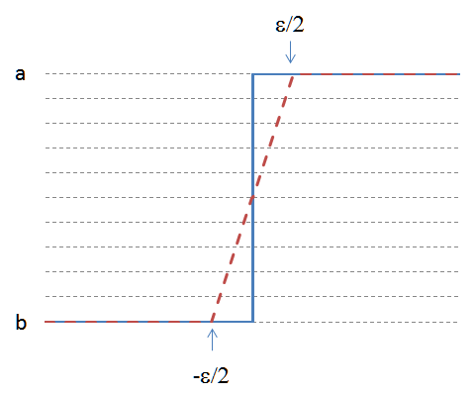
Smooth barrier
Hard barrier
100% dead above the barrier, 100% alive below the barrier
Hence, discontinuous
Soft barrier
100% dead above the barrier plus epsilon, 100% alive below the barrier minus epsilon
In between, lose a fraction of notional interpolated between (barrier-epsilon,0) and (barrier+epsilon,1)
And continue with the remaining notional
Hence, continuous
Smoothing and fuzzy logic
Like Schrodinger’s cat, the transaction is in a superposition of dead and alive states
Smoothing is achieved by replacing sharp logic (dead or alive?) by fuzzy logic (how much alive?)
More in the presentation

Slide 142
Simulation code with smooth barrier
template <class T>
inline T toyDupireBarrierMc(
// Spot
const T S0,
// Local volatility
const vector<T> spots,
const vector<T> times,
const matrix<T> vols,
// Product parameters
const T maturity,
const T strike,
const T barrier,
// Number of paths and time steps
const int Np,
const int Nt,
// Smoothing
const T epsilon,
// initialized random number generator
RNG& random)
// Initialize
T result = 0;
// double because the RNG is not templated (and doesn't need to be, see chapter 12)
vector<double> gaussianIncrements(Nt);
const T dt = maturity / Nt, sdt = sqrt(dt);
// Loop over paths
for (int i = 0; i < Np; ++i)
{
// Generate Nt Gaussian Numbers
random.nextG(gaussianIncrements);
// Step by step
T spot = S0, time = 0;
/* bool alive = true; */ T alive = 1.0; // alive is a real number in (0,1)
for (size_t j = 0; j < Nt; ++j)
{
// Interpolate volatility
const T vol = interp2D(spots, times, vols, spot, time);
time += dt;
// Simulate return
spot *= exp(-0.5 * vol * vol * dt + vol * sdt * gaussianIncrements[j]);
// Monitor barrier
/* if (spot > barrier) { alive = false; break; } */
if (spot > barrier + epsilon) { alive = 0.0; break; } // definitely dead
else if (spot < barrier - epsilon) { /* do nothing */ }; // definitely alive
else /* in between, interpolate */ alive *= 1.0 - (spot - barrier + epsilon) / (2 * epsilon);
}
// Payoff paid on surviving notional
/* if (alive && spot > strike) result += spot - strike; */ if (spot > strike) result += alive * (spot - strike);
} // paths
return result / Np;

Slide 143
Simulation code
The toy simulation code is found on the file ToyCode.h in the repo
To be compared with professional code in the files with names prefixed by “mc”
Our simple code returns the same result as the professional code
It is twice slower than the serial version of the professional code
On a quad-code computer, it is 8x slower than the parallel version
Next, we differentiate it with our simple AAD framework

Slide 144
Differentiation
Just like we did for Black & Scholes, to compute differentials, we:
Initialize the inputs as Numbers Which also records them on tape
Call our templated evaluation code, instantiated with the Number type Which performs the evaluation and records operations on tape
Propagate adjoints backwards through the tape
Pick differentials as the adjoints of the parameters

Slide 145
Differentiation code
void toyDupireBarrierMcRisks(
const double S0, const vector<double> spots, const vector<double> times, const matrix<double> vols,
const double maturity, const double strike, const double barrier,
const int Np, const int Nt, const double epsilon, RNG& random,
/* results: value and dV/dS, dV/d(local vols) */ double& price, double& delta, matrix<double>& vegas)
{
// 1. Initialize inputs
Number nS0(S0), nMaturity(maturity), nStrike(strike), nBarrier(barrier), nEpsilon(epsilon);
vector<Number> nSpots(spots.size()), nTimes(times.size());
matrix<Number> nVols(vols.rows(), vols.cols());
for (int i = 0; i < spots.size(); ++i) nSpots[i] = Number(spots[i]);
for (int i = 0; i < times.size(); ++i) nTimes[i] = Number(times[i]);
for (int i = 0; i < vols.rows(); ++i) for (int j = 0; j < vols.cols(); ++j) nVols[i][j] = Number(vols[i][j]);
// 2. Call instrumented evaluation code, which evaluates the barrier option price and records all operations
Number nPrice = toyDupireBarrierMc(nS0, nSpots, nTimes, nVols, nMaturity, nStrike, nBarrier, Np, Nt, nEpsilon, random);
// 3. Adjoint propagation, the exact same code as before, should be encapsulated in a dedicated function
vector<double> adjoints = calculateAdjoints(nPrice);
// 4. Pick results
price = nPrice.value;
delta = adjoints[nS0.idx];
for (int i = 0; i < vols.rows(); ++i) for (int j = 0; j < vols.cols(); ++j) vegas[i][j] = adjoints[nVols[i][j].idx];
}

Slide 146

Testing the code
We run the code in the same context as the initial demonstration but with 100,000 paths instead of 500,000
The computer runs out of memory and crashes!
Running AAD on a simulation with 100,000 paths consumes an insane amount of RAM
Even on a computer with enough memory, such large tape is cache inefficient

Slide 147
Solution in principle
Run a series of risks on mini-batches of say, 1024 paths and average in the end
Wipe the tape in between mini-batches
The average of differentials is the differential of the average
So we get the same results while reducing memory footprint to operations recorded over 1,024 paths
Note with mini-batches of size 1, this is known as “path-wise differentiation”
This is also a particular, and simple case of the general check-pointing algorithm explained in chapter 13

Slide 148
Solution in code
Rename our function DupireRisksMiniBatch(), call it sequentially from a wrapper function
void toyDupireBarrierMcRisks(
const double S0, const vector<double> spots, const vector<double> times, const matrix<double> vols,
const double maturity, const double strike, const double barrier,
const int Np, const int Nt, const double epsilon, RNG& random,
/* results: value and dV/dS, dV/d(local vols) */ double& price, double& delta, matrix<double>& vegas)
{
price = delta = 0;
for (int i = 0; i < vegas.rows(); ++i) for (int j = 0; j < vegas.cols(); ++j) vegas[i][j] = 0;
double batchPrice, batchDelta; matrix<double> batchVegas(vegas.rows(), vegas.cols());
int pathsToGo = Np, pathsPerBatch = 1024;
// calculate btach sensitivities sequentially
while (pathsToGo > 0)
{
// wipe tape
tape.clear();
// do mini batch
int paths = min(pathsToGo, pathsPerBatch);
dupireRisksMiniBatch(S0, spots, times, vols, maturity, strike, barrier, paths, Nt, epsilon, random, batchPrice, batchDelta, batchVegas);
// update results
price += batchPrice * paths / Np;
delta += batchDelta * paths / Np;
for (int i = 0; i < vegas.rows(); ++i) for (int j = 0; j < vegas.cols(); ++j) vegas[i][j] += batchVegas[i][j] * paths / Np;
pathsToGo -= paths;
}
}

Slide 149
Performance
With 100,000 paths, 156 steps, we compute the 1,081 differentials in around 7 seconds
This is 1,081 differentials in the time of around 6 evaluations
This is a very remarkable result, especially with such simplistic code
Try it yourself with the toy code in the repo!
This being said, the professional code is around 8 times faster in serial mode, 32 times faster in parallel mode on a quad-core laptop

Slide 150
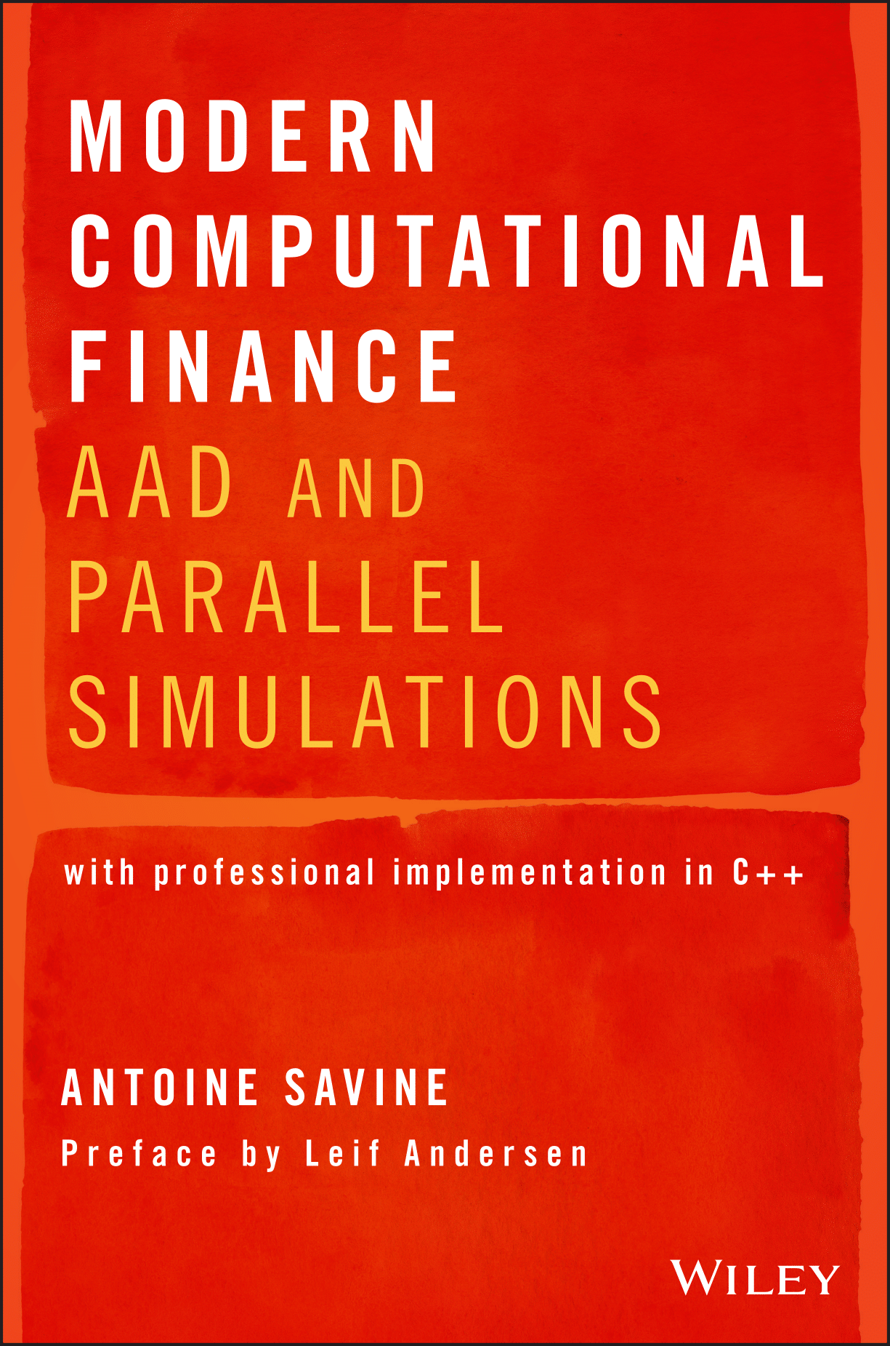
Conclusion
We learned AAD in principle and in code And applied it to machine learning and finance
But we really just scratched the surface
For example:
How to efficiently differentiate the multiple results of non-scalar functions?
How to compute risks not on model parameters like local volatilities But on tradable market variables like implied volatilities?
How to implement AAD in modern C++ and manage memory efficiently?
How to implement AAD over parallel simulations and run it at least 32x faster?
The answers, and much more, are in the book

Slide 151
Thank you for your attention. Find the slides here: go to http://github.com/asavine click on the repo ‘CompFinance’ download slides ‘Intro2AADinMachineLearningAndFinance.pdf’ download examples in the ‘Workshop’ folder see tutorial in the ‘xlCpp’ folder for exporting C++ code to Excel see basic AAD code in C++ in the file ‘toyCode.h’ the rest of the repo is companion code for the book Modern Computational Finance follow asavine on GitHub and watch the CompFinance repo to be notified of updates

